Slide 1
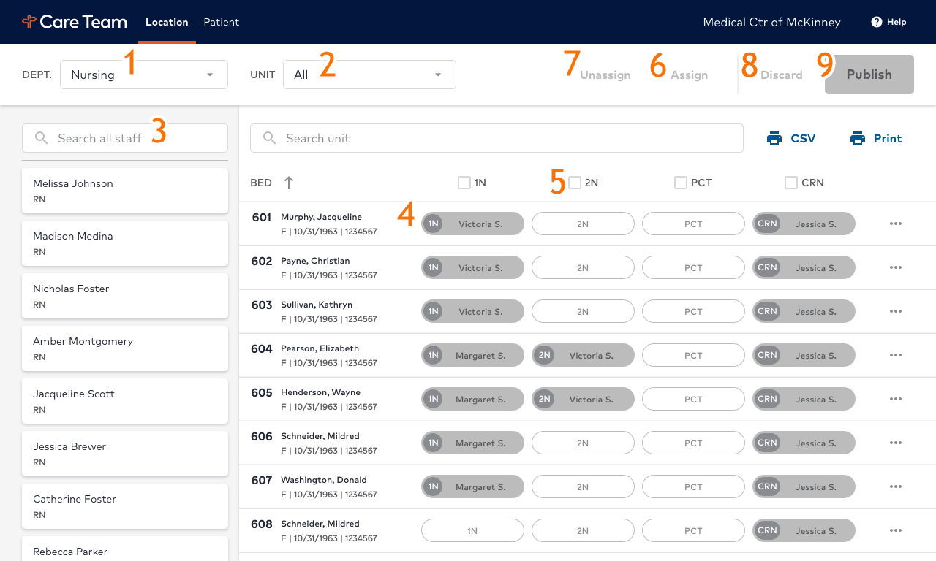

To make an assignment on the web version:
Select DEPT from drop-down menu
Select UNIT from drop-down menu
Select Staff name from left-hand column note: Staff name can also be filtered by
  entering name in search box
Select role bubble for selected staff
For mass assignments, check box of desired role (example: 2N)
Use Assign to add staff to bubbles
Use Unassign to remove staff from bubbles
To clear selection(s), click Discard
When ready to save and submit, Click Publish!
*Please do not use “Self-Assign” within Mobile Heartbeat, or make assignments in the Nurse Call System
For ongoing questions or troubleshooting, please contact ITG Support Services at 800.265.8422

Slide 2
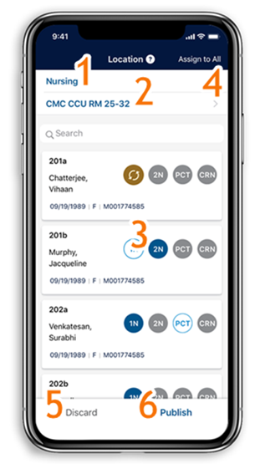
CTA will be your source of assignment for a patient’s dynamic care team in Mobile Heartbeat! User can make assignments with our web or iOS application.
Location Assignments:
When using the Location tab, a staff member will remain assigned to the selected bed until he/she is unassigned.
When a patient is moved into that bed in the electronic medical record, the assigned staff member will display on the patient's care team in Mobile Heartbeat.
Patient Assignments:
When using the Patient tab, a staff member will remain assigned to the selected patient until he/she unassigns within the application, or the patient is discharged.
As a patient moves locations within the hospital, the staff member will continue to be assigned to the patient's care team regardless of location.
Please contact <insert name>, Director of Clinical Informatics, for questions about your department’s participation.
Users can manage their own assignments via the iOS app!
Select your department from the top menu (example: Nursing)
Select the unit from lower menu
Select position bubble (example: 2N)
To assign yourself to same role for multiple patients/beds, click ‘Assign to All’
To clear selection(s), click Discard
When ready to save and submit assignments, Click Publish!
*Please do not use “Self-Assign” within Mobile Heartbeat, or make assignments in the Nurse Call System.
For ongoing questions or troubleshooting, please contact ITG Support Services at 800.265.8422

