Slide 1
Check Patch Reminder on eMAR
Go Live 11/26/19
Steven Weis, Pharm.D.
Medication Safety Officer, Pharmacy Dept.

Slide 2
Reasoning
There have been medication errors involving patches falling off prior to the next due time.
This will cause an interruption in medication delivery for an unknown amount of time for patients.
For example, a fentanyl patch falls off unknowingly, patient may go days with inadequate pain control.

Slide 3
Process
Pharmacy will add a check patch reminder on the emar for all fentanyl patches.
Reminder with be scheduled at 0900 with other daily medications.
  Do not confuse with remove patch reminder
RN will manually document reminder as an alert, and make any necessary notes, i.e. patch still in place, patch fell off, found in sheets, etc.

Slide 4
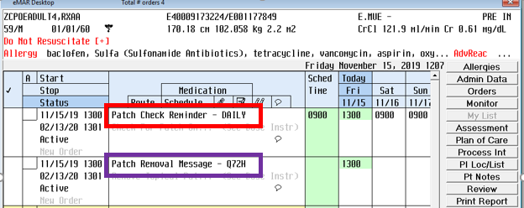
eMAR View

Slide 5
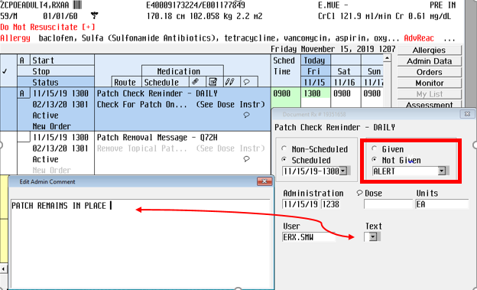
eMAR Documentation
For any questions or concerns, please notify pharmacy, *52630

