Slide 1

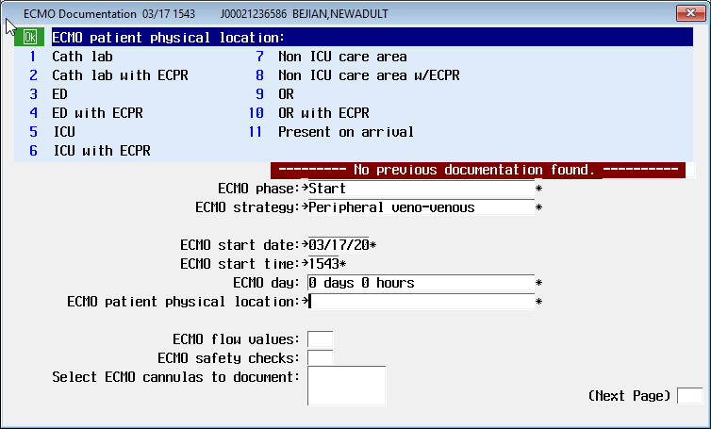
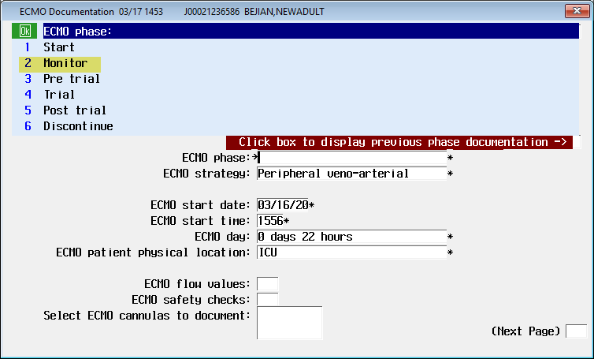
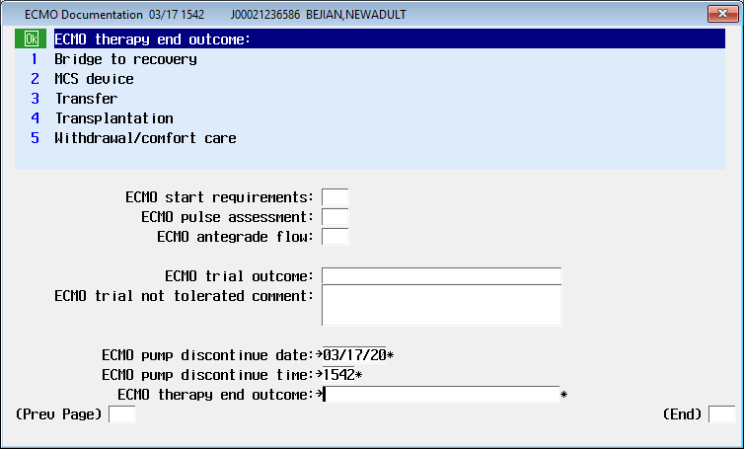




Extracorporeal Membrane Oxygenation (ECMO) EBCD Documentation
Utilize these MEDITECH screens to capture all ECMO Therapy documentation
ECMO Documentation Highlights:
Start Phase
  “Time on pump” is provided by the Start date/end date.
  ECMO strategy is needed:
    VV indicates pulmonary support only
    VA indicates arterial-venous support
Monitor Phase
  Key documentation elements include: flow values, safety checks, and cannula site assessment
  Documentation in the “ECMO trial outcome” field indicates the patient is progressing toward weaning, potentially in the next 24-48 hours.
Post Trial
  Collaborate with the provider to determine if the trial was tolerated.
Discontinue
  Discontinuation indicates the pump is now free.
ECMO is a life support machine that replaces the function of the heart and lungs. It is used when the lungs cannot provide enough oxygen to the body even when extra oxygen is provided, lungs cannot get rid of carbon dioxide even with the aid of a mechanical ventilator, or the heart cannot pump enough blood to the body.

Slide 2




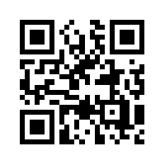


ECMO Guidance Document
Download these documents available on Atlas Connect
ECMO Supply Details Document
ECMO Modes:
Veno-Venous (VV)
Provides pulmonary support only
The heart will continue to work normally
The ECMO machine will drain the blood through the cannula, oxygen will be added to the blood, carbon dioxide will be removed, and the blood will be returned to the right side of the heart
The heart will pump the oxygenated blood to the body
Veno-Arterial (VA)
Provides support for both lungs and heart
The ECMO machine will drain the blood through the cannula, add the oxygen and remove the carbon dioxide, return the blood, and force the blood acting as the heart through the body
This method bypasses the heart and lungs
https://connect.medcity.net/web/covid-19/covid-ready
Why is ECMO Documentation Important?
In order to support evidence-based clinical care and gain insight regarding use of ECMO across HCA Healthcare, Accurate and Timely documentation is needed.
Be sure to document the Discontinue phase of ECMO. Without the discontinue piece, we have no insight into the following:
Number of active patients on ECMO across HCA Healthcare
Total time spent on ECMO
De-cannulation information
Patient outcomes
ECMO Family meeting Process
Scan QR Code for
ECMO Guidance document
Establish Family meetings ASAP as patient goes on ECMO Support
Multidisciplinary approach is needed (physicians, nurses, care coordination, etc.)
During Family meetings, address topics such as:
  Therapy goals
    recovery vs. need for transplant or other assistive device
  Progress to Goals
  Key Milestones (Weaning Trials w/in 24-48hrs)
  Key Decisions that need to be made by family
Questions about documentation?
CORP.EBCD@HCAHealthcare.com

