Slide 1


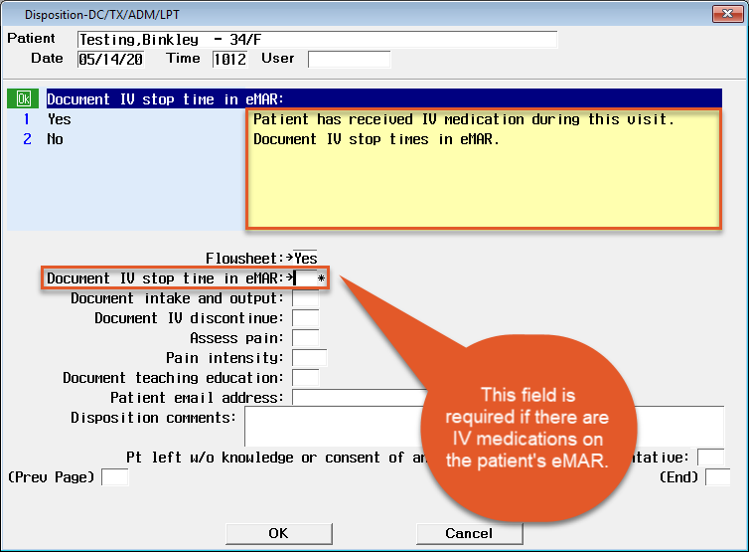
ED Discharge Disposition and IV Stop Times
‘Document IV stop time in eMAR’ field: A yellow information box alerts clinicians if an IV medication has been documented. This will ensure proper documentation of the IV stop time.
If an IV medication has been documented on the patient’s eMAR, this will be a required field.
Clinicians will be able to stop IV medications started by another nurse.

Slide 2
