Slide 1
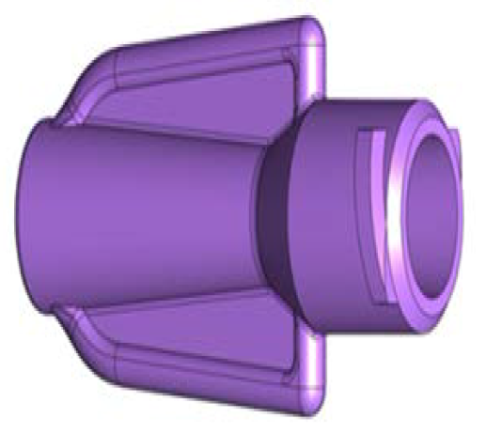
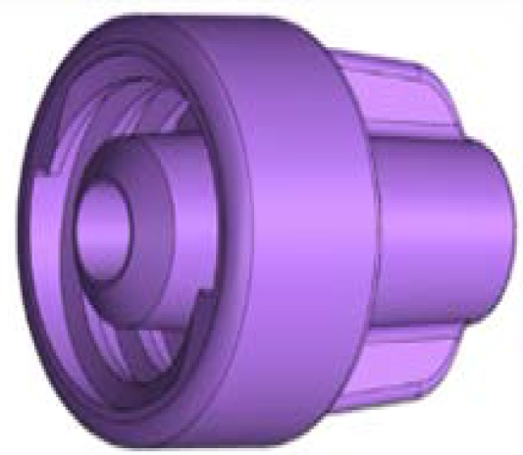

ENFit® ENTERAL SYSTEM CONNECTION
Kangaroo™
ENFit Pump Set
Kangaroo™
ENFit Access Device
Anika Owen
Cardinal Health - Account Rep
913-449-5914
anika.owen@cardinalhealth.com

Slide 2
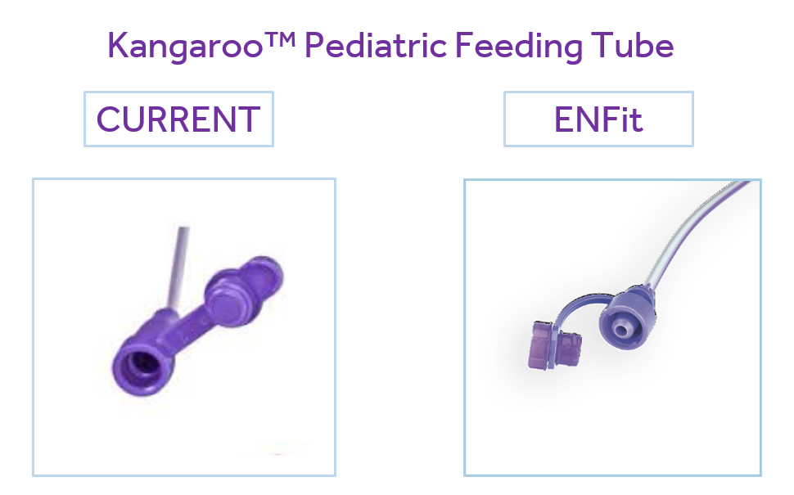
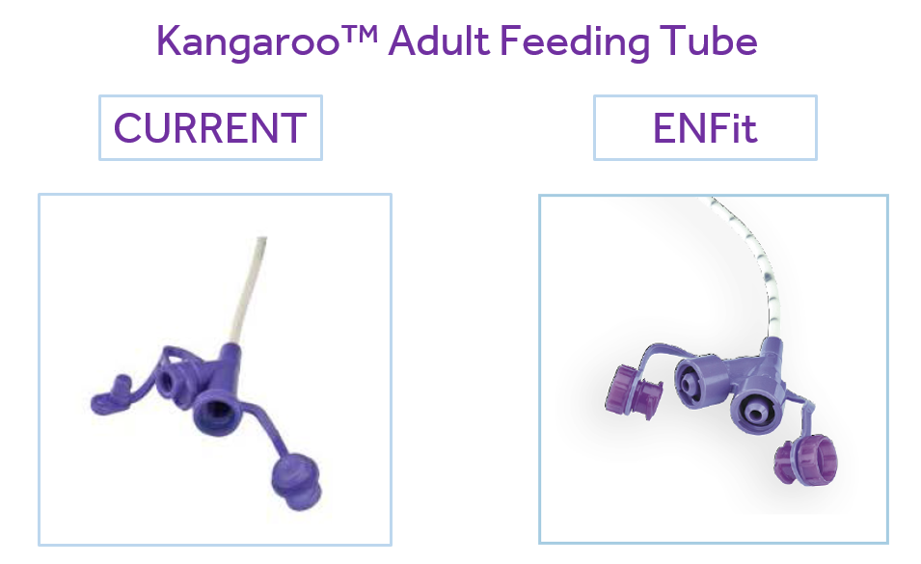
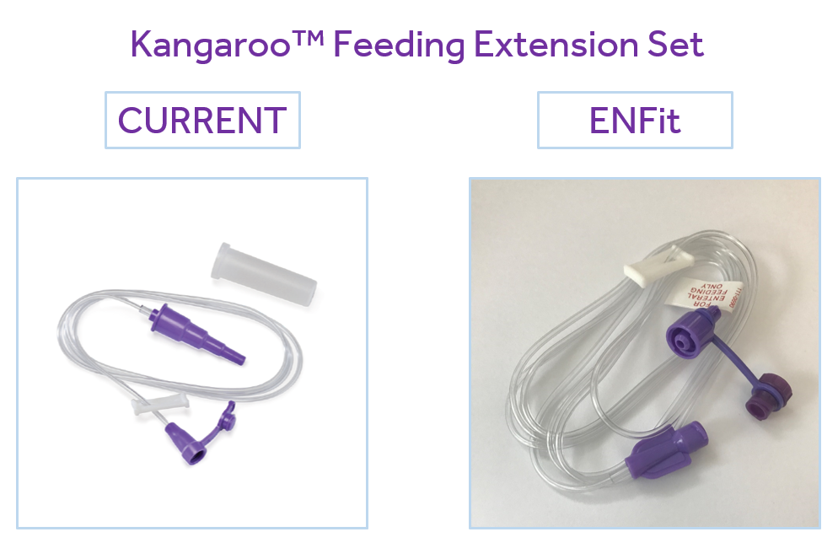


Slide 3
