Slide 1

USP <800>: Safe Handling of Hazardous Drugs
CWT Clinical/Nursing Education

Slide 2
Overview
Handling Hazardous Drugs in Healthcare Settings
1. Introduction to USP <800>
4. Compounding
5. Administration
7. Cleaning and Spill Response
2. Hazardous Communication
3. Personal Protective Equipment
8. Exposure and Medical Surveillance
6. Transportation and Disposal
United States Pharmacopeia, Chapter <800> is a federally mandated regulation that broadens the definition of hazardous drugs and outlines safe practices for employees handling hazardous drugs.

Slide 3
Introduction to USP <800>
Handling Hazardous Drugs in Healthcare Settings
Effective Date: December 1, 2019
Enforceable By: FDA, The Joint Commission, and CMS
Objectives:
  Worker Safety (all healthcare personnel who handle hazardous drugs)
  Patient Safety
  Environmental Protection
Scope:
Receiving
Compounding
Transport
Administration
Disposal

Slide 4
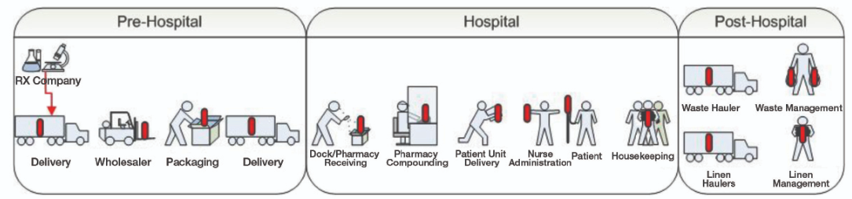
Introduction to USP <800>
Handling Hazardous Drugs in Healthcare Settings
USP <800> represents new guidelines on protecting our employees and environment from everyday cumulative or accidental exposure to the drugs we use to treat our patients.
It expands the definition of Hazardous Drugs (HD) to include many drugs we use on an everyday basis that have not historically been considered hazardous.
A drug is considered Hazardous if exposure may cause unwanted changes to the health of a Healthcare Worker.
The red represents touch points to a hazardous drug during its life cycle.

Slide 5
Hazardous Communication
Handling Hazardous Drugs in Healthcare Settings
What Makes a Drug Hazardous?
Carcinogenic
Ability to cause cancer
Teratogenic
Ability to produce fetal malformations
Reproductive Toxicity
May have adverse effects to the male/female reproductive system
Organ Toxicity
May have adverse effects to organs
Genotoxic
Ability to mutate DNA

Slide 6
Hazardous Communication
Handling Hazardous Drugs in Healthcare Settings
Examples of Hazardous Drugs
Anti-Neoplastic
Gemcitabine
Non-Antineoplastic
Cyclosporine
Divalproex
Reproductive Risks
Cervadil
Oxytocin
Valganciclovir
Cisplatin
Premarin
Mitomycin

Slide 7

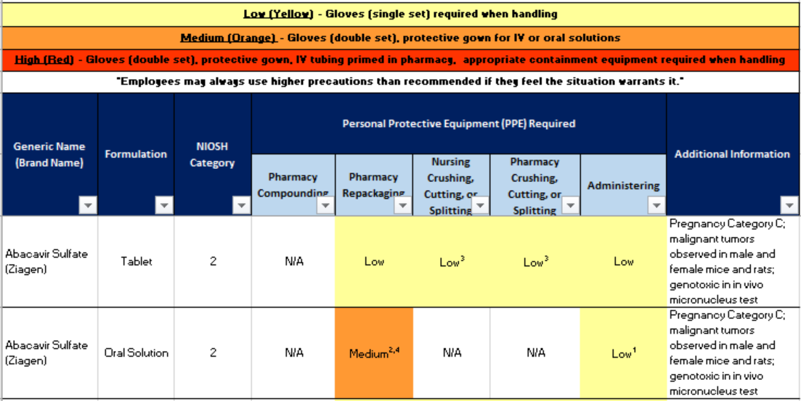
Hazardous Communication
Handling Hazardous Drugs in Healthcare Settings
Each Facility Must Maintain a List of ALL Hazardous Drugs Used
The List Must Be Updated Annually

Slide 8
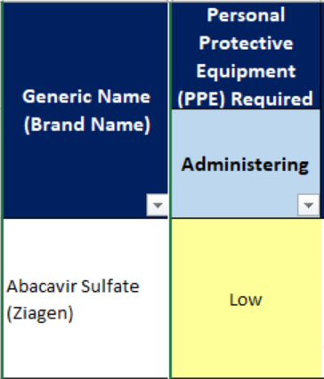

Hazardous Communication
Handling Hazardous Drugs in Healthcare Settings
Interpreting the Hazardous Drug List
Low/Medium/High will tell you the level of PPE to wear and precautions to take for the activity
LOW (YELLOW): Gloves (single set) required when handling, tablets may be crushed by nursing
MEDIUM (ORANGE): Gloves (double set), chemotherapy gown (for IV or oral solution), Pharmacy will crush tablets
HIGH (RED): Gloves (double set), chemotherapy gown, appropriate containment equipment required when handling, tubing will be primed in Pharmacy

Slide 9



Hazardous Communication
Handling Hazardous Drugs in Healthcare Settings
Look for these labels on drugs for handling guidelines
Low Risk
Hazardous Drugs
Medium Risk
Hazardous Drugs
High Risk
Hazardous Drug
Administration:
ONE pair of gloves for all dose forms
Eye protections and mask if splashing is possible
Crush or split tablets in a plastic bag
Wash hands after administration
Disposal:
Place all materials (drug packaging, cup, gloves, etc.) into waste container
Transport:
TUBING ALLOWED
Administration:
TWO pairs of gloves for all dose forms
Chemotherapy gown for IV or oral solutions
Eye protection and mask if splashing is possible
Pharmacy to cut or split tablets
Closed System Transfer Devices (CSTDs) used as appropriate
Wash hands after administration
Disposal:
Place all materials (drug packaging, cup, gloves, etc.) into a SEALED plastic bag
Place the sealed plastic bag into the YELLOW or BLACK hazardous waste container
Transport:
Check the “DO NOT TUBE” list before tubing
Administration:
TWO pairs of gloves AND a chemotherapy gown for all dose forms
Eye protection and mask if splashing is possible
IV tubing primed in pharmacy
Closed System Transfer Devices (CSTDs) as appropriate
Wash hands after administration
Disposal:
Place all materials (drug packaging, cup, gloves, etc.) into a SEALED plastic bag
Place the sealed plastic bag into the YELLOW or BLACK hazardous waste container
Transport:
DO NOT TUBE

Slide 10

Hazardous Communication
Handling Hazardous Drugs in Healthcare Settings
Low Risk Hazardous Drugs
Administration:
ONE pair of gloves for all dose forms
Eye protections and mask if splashing is possible
Crush or split tablets in a plastic bag
Wash hands after administration
Disposal:
Place all materials (drug packaging, cup, gloves, etc.) into waste container
Transport:
TUBING ALLOWED

Slide 11

Hazardous Communication
Handling Hazardous Drugs in Healthcare Settings
Medium Risk Hazardous Drugs
Administration:
TWO pairs of gloves for all dose forms
Chemotherapy gown for IV or oral solutions
Eye protection and mask if splashing is possible
Pharmacy to cut or split tablets
Closed System Transfer Devices (CSTDs) used as appropriate
Wash hands after administration
Disposal:
Place all materials (drug packaging, cup, gloves, etc.) into a SEALED plastic bag
Place the sealed plastic bag into the YELLOW or BLACK hazardous waste container
Transport:
Check the “DO NOT TUBE” list before tubing

Slide 12

Hazardous Communication
Handling Hazardous Drugs in Healthcare Settings
High Risk Hazardous Drugs
Administration:
TWO pairs of gloves AND a chemotherapy gown for all dose forms
Eye protection and mask if splashing is possible
IV tubing primed in pharmacy
Closed System Transfer Devices (CSTDs) required
Wash hands after administration
Disposal:
Place all materials (drug packaging, cup, gloves, etc.) into a SEALED plastic bag
Place the sealed plastic bag into the YELLOW or BLACK hazardous waste container
Transport:
DO NOT TUBE

Slide 13
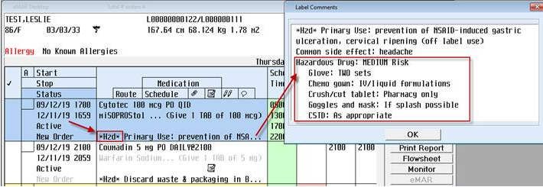
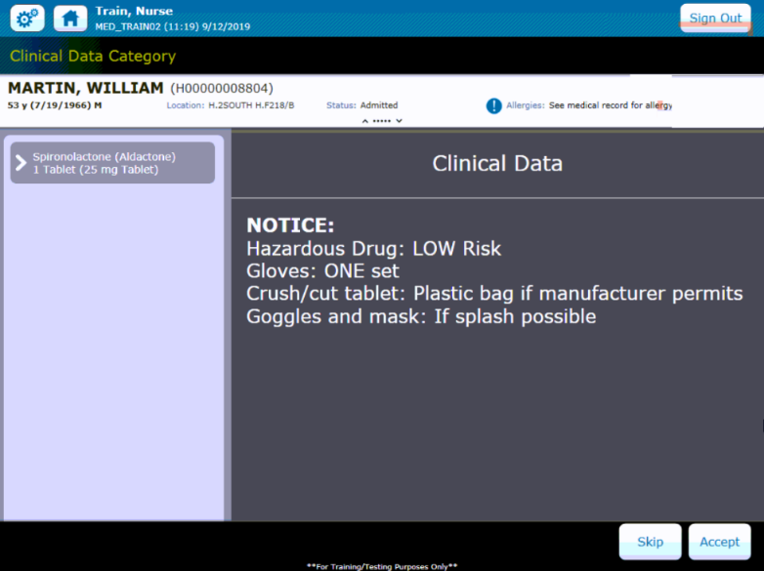
Hazardous Communication
Handling Hazardous Drugs in Healthcare Settings
*Hzd*
Medications will be electronically designated in MEDITECH and Pyxis
MEDITECH
Pyxis

Slide 14
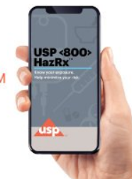
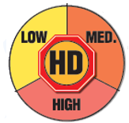
Hazardous Communication
Handling Hazardous Drugs in Healthcare Settings
Where Do I Find Additional Information?
Download the HD App
Refer to the HD Label
Talk to you Facility HD Coordinator, Employee Health Nurse or Department Leader

Slide 15
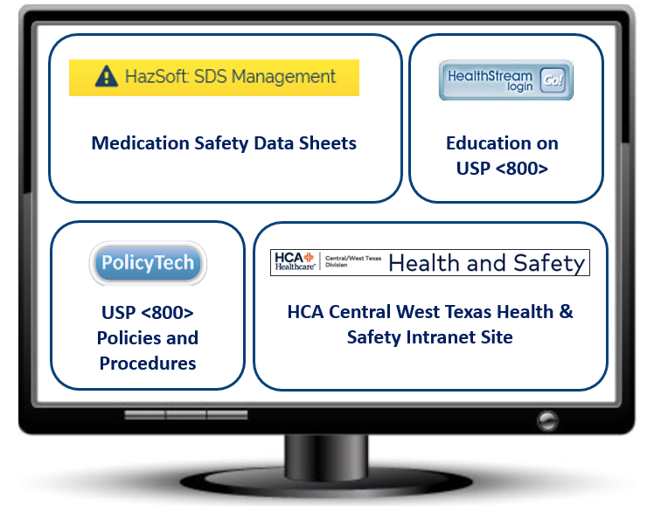
Hazardous Communication
Handling Hazardous Drugs in Healthcare Settings
Where Do I Find Additional Information?

Slide 16
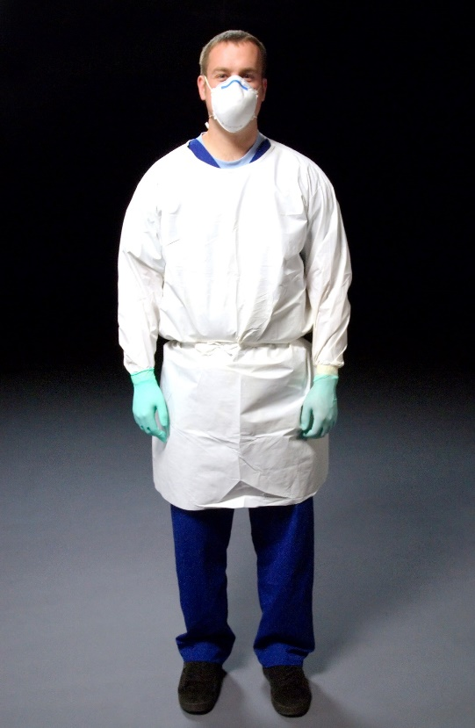
Personal Protective Equipment (PPE)
Handling Hazardous Drugs in Healthcare Settings
Changes to Personal Protective Equipment
PPE must be worn when indicated
Minimum PPE requirements are outlined on the Hazardous Drug list
Additional PPE can always be worn if the user desires or thinks it is necessary
Remember:
To ensure safety, always check the HD label or list
Additional PPE may be required in your unit
Consult your Unit Manager or HD Coordinator

Slide 17
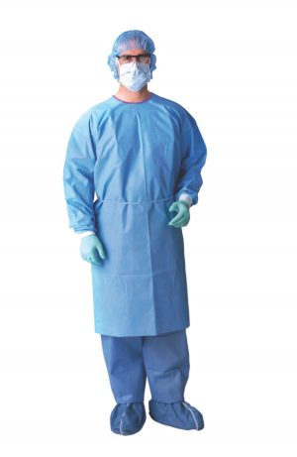
Personal Protective Equipment (PPE)
Handling Hazardous Drugs in Healthcare Settings
Gowns
Gowns supplied will be USP 800 compliant
  Close in the back
  Long sleeved
  Closed cuffs
  No seams
Dispose of after each use
Do not wear between patients

Slide 18
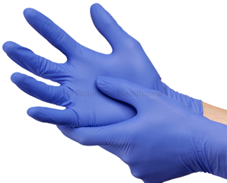
Personal Protective Equipment (PPE)
Handling Hazardous Drugs in Healthcare Settings
Gloves
Gloves supplied will meet American Society for Testing and Materials (ASTM) D6978
Wear when handling all hazardous drugs
Replace at least every 30 minutes or if torn or integrity is compromised
Hands must be washed with soap and water after removing gloves

Slide 19
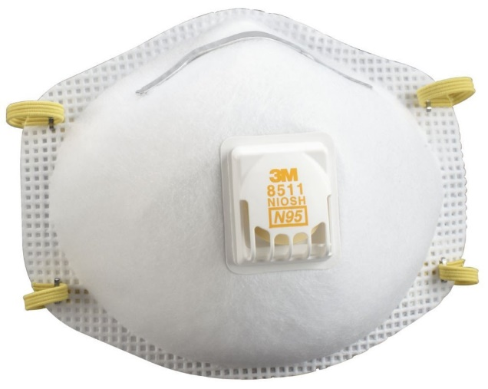
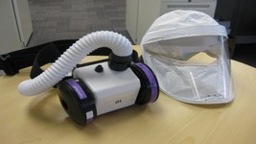
Personal Protective Equipment (PPE)
Handling Hazardous Drugs in Healthcare Settings
Respiratory Protection
Wear an N95 mask when:
  Crushing tablets
  Airborne particles are present
Wear a Powered Air-Purifying Respirator (PAPR) when:
  Known or suspected exposure to vapors (medication will be clearly identified)
  Cleaning large spills
  Primarily used in Pharmacy

Slide 20
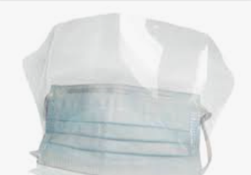

Personal Protective Equipment (PPE)
Handling Hazardous Drugs in Healthcare Settings
Eye and Face Protection
Face shields AND goggles:
  Full range of protection
  Wear when there is a risk for spills or splashes of HDs
  Face shields alone do not provide full eye and face protection
  Spit shields do not offer required protection

Slide 21

Compounding
Handling Hazardous Drugs in Healthcare Settings
Do NOT compound any IV hazardous drugs outside of the Pharmacy.
Pharmacy will compound all IV hazardous drugs.

Slide 22

Administration
Handling Hazardous Drugs in Healthcare Settings
 | Low Risk
IV | ONE set of gloves Wash hands after administration
Tablet/ Capsule | ONE set of gloves Crushed/split in plastic bag N95 if particles generated Wash hands after administration
Liquid* | ONE set of gloves Eye protection and mask if splashing is possible Wash hands after administration
*oral, via a PEG tube, etc.

Slide 23

Administration
Handling Hazardous Drugs in Healthcare Settings
 | Medium Risk
IV | TWO pairs of gloves Chemotherapy gown Eye protection and mask if splashing is possible Closed System Transfer Devices (CSTDs) used as appropriate Wash hands after administration
Tablet/ Capsule | TWO pairs of gloves Crushed/split in pharmacy Wash hands after administration
Liquid* | TWO pairs of gloves Chemotherapy gown Eye protection and mask if splashing is possible Wash hands after administration
*oral, via a PEG tube, etc.

Slide 24
Administration
Handling Hazardous Drugs in Healthcare Settings
 | High Risk
IV | TWO pairs of gloves Chemotherapy gown Eye protection and mask if splashing is possible IV tubing primed and attached in pharmacy Closed System Transfer Device (CSTD) required Wash hands after administration
Tablet/ Capsule | TWO pairs of gloves Chemotherapy gown Eye protection and mask if splashing is possible Wash hands after administration
Liquid* | TWO pairs of gloves Chemotherapy gown Eye protection and mask if splashing is possible Wash hands after administration
*oral, via a PEG tube, etc.

Slide 25
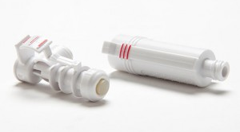
Administration
Handling Hazardous Drugs in Healthcare Settings
Closed System Transfer Devices (CSTD)
CSTDs prohibit the transfer of environmental contaminants into the medication system and the escape of hazardous drugs or vapors outside the system
Used for:
  ALL IV Antineoplastics
  Some designated non-antineoplastic IV medications
CSTD as Appropriate
CSTD Required

Slide 26
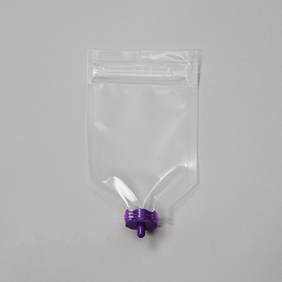
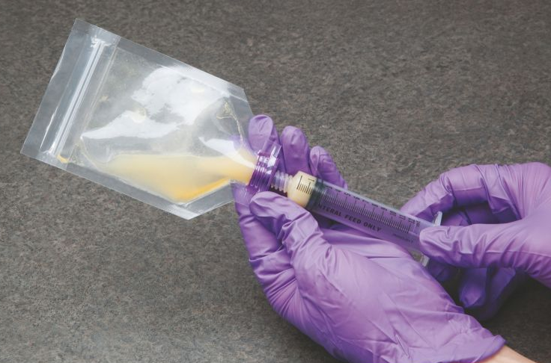
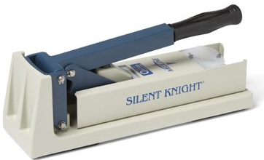
Administration
Handling Hazardous Drugs in Healthcare Settings
RxCrush
A closed system to crush hazardous drugs
Use for LOW risk medications by nursing
Use in accordance with manufacturer recommendations
Place pill in plastic pouch to crush
Crush pill
Using syringe, insert water into pouch, dissolve crushed pill, and withdraw liquid back into syringe to administer

Slide 27


Transport and Disposal
Handling Hazardous Drugs in Healthcare Settings
Transport
Caution should be taken when transporting hazardous drugs
DO
NOT
TUBE
Liquid*
*oral, via a PEG tube, etc.

Slide 28

Transport and Disposal
Handling Hazardous Drugs in Healthcare Settings
Transport
Transport containers will be used to prevent spillage/leakage of HIGH risk HD’s between departments
Liquid chemo MUST NOT be transported via pneumatic tubes
Check the “DO NOT TUBE” list
Chemo will be delivered to where the patient is located

Slide 29

Transport and Disposal
Handling Hazardous Drugs in Healthcare Settings
LOW Risk Hazardous Drugs
Disposal for LOW Risk Drugs:
Place all materials into the trash
Trash
Drug Packaging
Medication Cup
Gloves

Slide 30
Transport and Disposal
Handling Hazardous Drugs in Healthcare Settings
MEDIUM Risk Hazardous Drugs
Disposal for MEDIUM Risk Drugs:
Yellow HD Bag
Drug Packaging
Medication Cup
Gloves
Yellow Trash Bin
Black Trash Bin

Slide 31
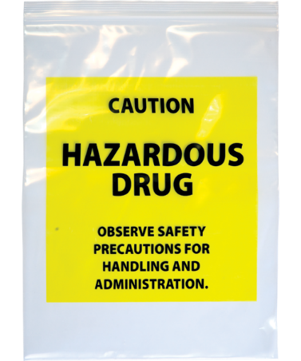
Transport and Disposal
Handling Hazardous Drugs in Healthcare Settings
HIGH Risk Hazardous Drugs
Disposal for HIGH Risk Drugs:
Yellow HD Bag
Drug Packaging
Medication Cup
Gloves
Yellow Trash Bin
Black Trash Bin

Slide 32
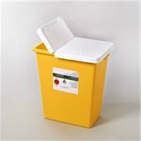
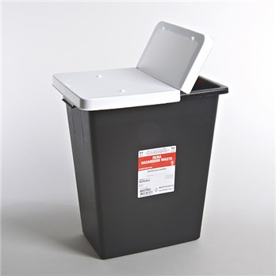
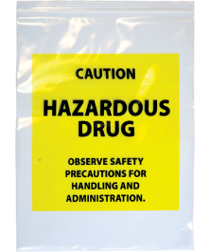
Disposal
Handling Hazardous Drugs in Healthcare Settings
Hazardous Drug Disposal
Trace | Bulk
MEDIUM or HIGH risk drugs | MEDIUM or HIGH risk drugs
< 3% of original weight/volume remains | > 3% of original weight/volume remains
Yellow Waste Container | Black Waste Container
DO
NOT
TUBE

Slide 33
Cleaning and Spill Response
Handling Hazardous Drugs in Healthcare Settings
Routine cleaning will occur to prevent surface contamination and personnel exposure to hazardous drugs
Appropriate cleaning agents and techniques will be used by those cleaning
EVS
Cleaning of surfaces in room
Sterile Processing
Cleaning of medical equipment
Outside Vendors
Laundering services
Pharmaceutical waste disposal

Slide 34
Cleaning and Spill Response
Handling Hazardous Drugs in Healthcare Settings
Spill Response Process
Each hospital will have a Spill Emergency Response Team (SERT) to respond to large spills.
Members of the SERT may be physically present to attend to spills or may be available remotely to advise on spill containment and cleaning procedures.
SERT
Facility Emergency Management
Pharmacy
House Supervisor
EVS

Slide 35
Cleaning and Spill Response
Handling Hazardous Drugs in Healthcare Settings
Spill Cleaning Steps
Employees will be trained to clean minor (<5 mL) spills of hazardous drugs
Prevent Spill from Spreading
Obtain Spill Kit
Don Appropriate PPE
Clean Spill Using Kit Contents
Dispose of Spill Kit in Black Waste Bin
Call EVS to Clean Spill Area

Slide 36
Cleaning and Spill Response
Handling Hazardous Drugs in Healthcare Settings
Spill Response Process
< 5 mL | Employee Uses Spill Kit | Employee Uses Spill Kit | Employee Uses Spill Kit
> 5 mL | Employee Uses Spill Kit | Employee Calls SERT | Employee Calls SERT
Employees may call the SERT any time they feel it is necessary

Slide 37
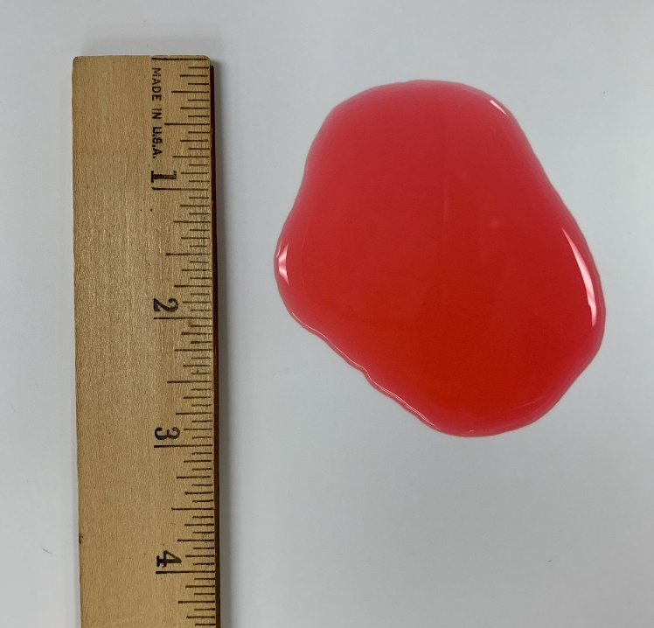
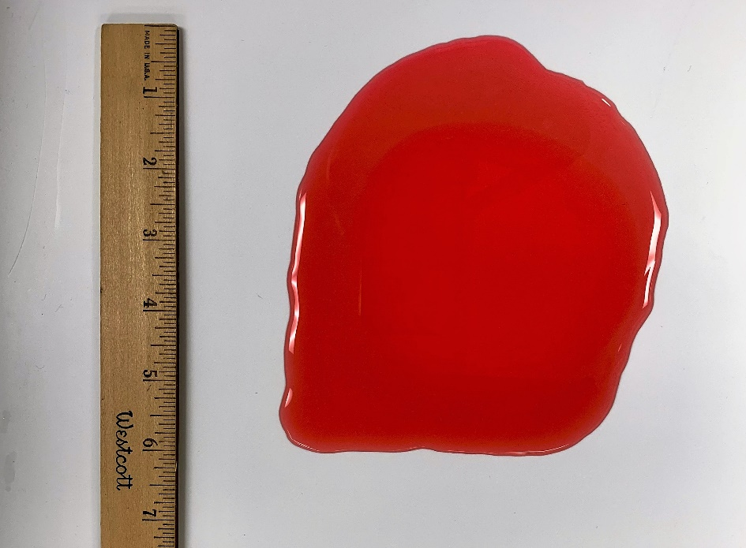
Cleaning and Spill Response
Handling Hazardous Drugs in Healthcare Settings
5 mL
50 mL
Spill Kit
Spill Kit
Spill Kit
Employee Calls SERT
Spill Kit
Employee Calls SERT

Slide 38
Exposure and Medical Surveillance
Handling Hazardous Drugs in Healthcare Settings
Routes of Exposure
Absorption
Inhalation
Injection
Ingestion
Skin or mucous membrane contact
Sharps injuries
Contaminated foodstuffs, hand-to-mouth contaminants
Priming IV sets, generating aerosols

Slide 39
Exposure and Medical Surveillance
Handling Hazardous Drugs in Healthcare Settings
Medical surveillance of employees will be used to track exposures and any adverse effects experienced by employees
High Risk Employees
Health
Survey
All Employees Handling HDs
Exposure Education
Surveys and education will be administered annually by Employee Health
If employees do not wish to participate, they will be required to opt-out

Slide 40

Close
Handling Hazardous Drugs in Healthcare Settings
Questions?
Talk to you Facility HD Coordinator, Employee Health Nurse or Department Leader
Refer to the HD Label
Download the HD App
Talk to your
Facility Employee Health Nurse

Slide 41
Post-Education Competency
Handling Hazardous Drugs in Healthcare Settings
Why is it Important to know how to handle hazardous drugs?
  Because exposure to hazardous drugs can cause reproductive complications for me and my fellow colleagues if handled improperly
  Because it is interesting
  Because joint commission will ask
  Because St. Davids HealthCare and HCA requires it
Which of the following makes a drug hazardous?
  Reproductive Toxicity
  Teratogenic
  Organ Toxicity
  All of the above
How do I determine what PPE to wear and precautions to take when administering a hazardous drug?
  Patient’s diagnosis
  Patient’s location within the hospital
  Red, Orange and Yellow HD label on the medication
What is the best way to protect yourself from hazardous drug exposure?
  Do nothing, it’s not important
  Familiarize yourself with your facilities guidelines for safe hazardous drug handling
  Follow your facility's guidelines during every step of hazardous drug handling
  Both B & C
How can I gather additional hazardous drug information?
  Download the HD App
  Refer to the HD label
  Speak with your Facility HD Coordinator, Employee Health Nurse, or Department Leader
  All the above

