Slide 1
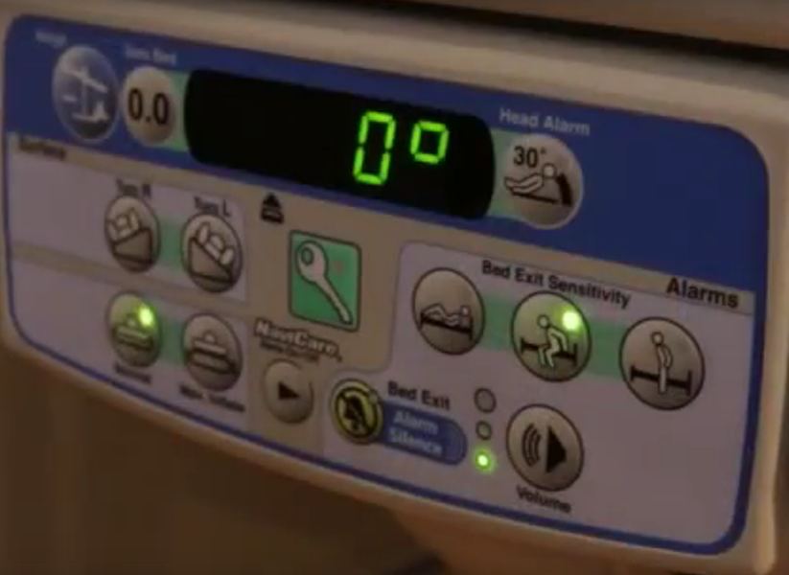
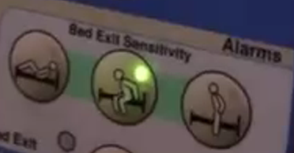
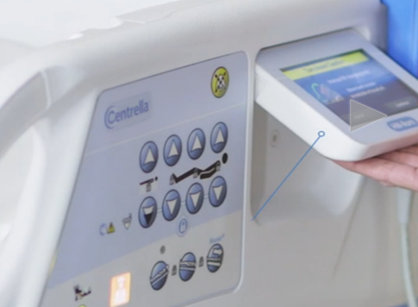
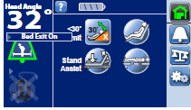

Bed Exit Alarms
How do you know the bed alarm is armed on your patient’s bed?
Solid Green Light
Indicates Bed Exit Is On
Solid Green Light
Indicates Bed Exit Is On
VERSA CARE BEDS
When selecting the bed exit mode, the bed should beep ONCE and the light within the bed exit mode button will stay lit.
Bed Exit is NOT on with 3 beeps and the light does not stay on.
If the bed exit does not turn on check that the patient’s weight is accurate and that the patient is centered in the bed.
  Accurate weight should be captured after bed scale is “zeroed” without the patient on the bed.
CENTRELLA BEDS
When selecting the bed exit mode, the bed should beep ONCE and the light within the bed exit mode button will stay lit.
Bed Exit is NOT on with 3 beeps and the light does not stay on.
If the bed exit does not turn on check the patient weight and that the patient is centered in the bed.
  Minimum weight is 70 lbs.
HealthStream link

Slide 2
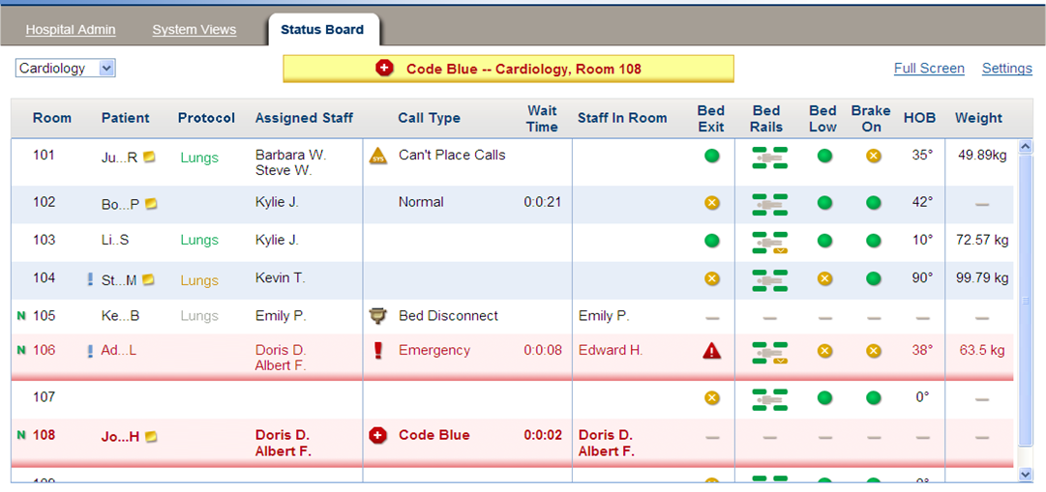
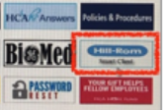
Accessing Status Board in HillRom Nurse Call to Monitor
Bed Exits Armed on Fall Risk Patients
Click the “Status Board” tab within the “System View” screen
From your facility intranet/Atlas,
Click on Hill-Rom Smart Client
Make sure that bed exit is green if patient is at risk for falls and bed exit alarm needs to be armed
If patient is at risk for falls, bed should be in the lowest position with the brakes engaged
Hillrom nurse call status board* displays green solid icon when bed exit is armed on either bed

