Slide 1

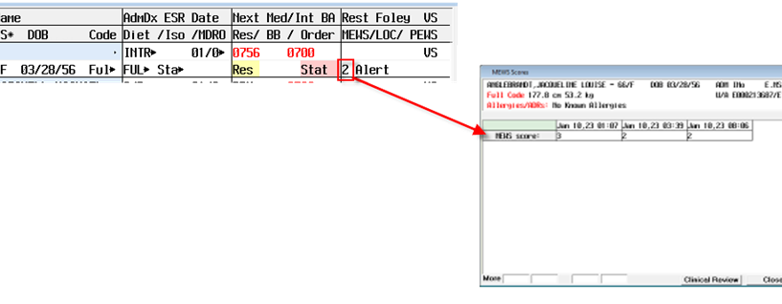
MEWS Update January 2023
From the status board click on MEWS. Then you will be able to see the most recent 7 days of MEWS scores.
MEWS is the Modified Early Warning System that aids in early recognition, intervention and stabilization of patients experiencing clinical deterioration.
Regular measurement and documentation is essential for recognizing deterioration.
Please review the policy.
You are now able to view the last 7 days of MEWS scores from the status board!

Slide 2
Modified Early Warning System (MEWS)
Purpose is to identify early warning signs of potential patient deterioration.
MEWS score is based on heart rate, blood pressure, respiratory rate, temperature, and level of consciousness. All 5 aspects must be documented in the electronic health record.
MEWS score of 5 or more, or a change of 2 or more is an indicator of potential clinical instability and requires immediate assessment and documentation.
Interventions may include notifying the physician, deploying a rapid response, and/or transfer to higher level of care.
Nursing Considerations:
MEWS is a tool for early identification, intervention, and stabilization for patient experiencing unexpected deterioration
MEWS is not a replacement for good clinical judgement
If the MEWS score indicates potential instability, assess the patient
RNs are responsible for monitoring changes in MEWS score when vital signs are assessed
CNAs are responsible for communicating changes in MEWS score to the patient’s primary RN
Components | 3 | 2 | 1 | 0 | 1 | 2 | 3
Systolic Blood Pressure (mmHg) | <70 | 71-80 | 81-100 | 101-199 |  | ≥200
Pulse Rate (HR) (bpm) |  | <40 | 41-50 | 51-100 | 101-110 | 111-129 | ≥130
Respiratory Rate (rpm) |  | <9 |  | 9-14 | 15-20 | 21-29 | ≥30**
Temperature (C) |  | <35 |  | 35-38.4 |  | ≥38.5
AVPU Score |  |  |  | Alert | Reacting to Voice | Reacting to Pain | Unresponsive
**Per policy, data that falls into more critical findings (shaded on scoring grid) require immediate action by the RN. Call Physician/RRT Stat for any shaded coded emergent situation unless existing orders provide care parameters. Exceptions to the chain of response include patients that are not able to maintain an airway or a patient with obvious signs of hemodynamic instability.

