Slide 1
TNKase (Tenecteplase) for Acute Ischemic Stroke Treatment

Slide 2
Objectives
Understand change in practice from utilizing IV Alteplase (tPA) to use of TNKase (Tenecteplase) for Acute Ischemic Stroke (AIS) at Medical City Hospitals
Identify appropriate use of disclosure and consents in use of TNKase (Tenecteplase)
Recognize contraindications to use of TNKase (Tenecteplase) for Acute Ischemic Stroke (AIS)
Describe correct process for reconstitution and administration of TNKase (Tenecteplase) for Acute Ischemic Stroke (AIS)
Define the correct patient care and monitoring after the use of TNKase (Tenecteplase) for Acute Ischemic Stroke (AIS)

Slide 3
What is TNKase (Tenecteplase)?
TNKase (TENECTEPLASE) is a single-bolus thrombolytic agent. It is a clot busting medication.
TNKase (TENECTEPLASE) has been approved as the primary IV thrombolytic drug for Acute Ischemic Stroke (AIS) at Medical City Hospitals.
TNKase (Tenecteplase) use in AIS is considered an “off label” use, but with evidence suggesting similar efficacy and toxicity to IV Alteplase (tPA).
TNKase (Tenecteplase) is associated with longer half-life than IV Alteplase (20-24 minutes), greater fibrin specificity and ease of administration due to lack of need for infusion.
The aim for TNKase (Tenecteplase) is to achieve rapid arterial perfusion to improve patient outcomes in an acute ischemic stroke.

Slide 4


What are some benefits of TNKase (Tenecteplase)?
Tenecteplase
Thrombolytic
Advantages
Clinical Outcomes
Genetically modified variant of alteplase
Has greater fibrin specificity
Longer T_{1/2} that permits bolus administration
Quicker preparation
Single bolus is administered intravenously over 5 seconds
No infusion dose
No need 50ml of normal saline post infusion
As effective and safe as alteplase
Better early reperfusion and functional outcome in patients who received tenecteplase and mechanical thrombectomy compared to those treated with alteplase and mechanical thrombectomy

Slide 5
Who can receive TNKase (Tenecteplase)?
Inclusion criteria:
Clinical diagnosis of acute ischemic stroke causing measurable neurological disability
Last known well time < 4.5 hours before beginning treatment or per Wake-Up protocol
Age ≥ 18 years
***A consent form is not needed for Tenecteplase,
the provider will obtain consent from the patient/family and explain the risks, benefits and alternatives to treatment and document in the medical record.

Slide 6
Who should not receive TNKase (Tenecteplase)?
Age < 18 years
Elevated BP >185/>110 mmHg
Platelet count < 100,000 mm³
Head trauma or previous AIS in past 3 months
Signs or symptoms of bleeding (i.e, subarachnoid hemorrhage, internal bleeding, etc.) or high risk of bleeding (i.e, previous intracranial hemorrhage, being within 7 days of an arterial puncture at a non-compressible site, recent intracranial/spinal surgery or lumbar puncture, head CT showing hypodensity from recent cerebral infarction, acute bleeding diathesis, an intracranial intra-axial neoplasm, or a vascular malformation)
Anticoagulation:
  Heparin within 48 hours: ↑ aPTT > 40 seconds
  Current warfarin use: INR > 1.7
  Direct thrombin/factor Xa inhibitors: UNLESS labs are normal OR the patient has not received a dose in > 2 days
    Normal Labs:
      Anti-Xa <0.3 for Eliquis (apixaban), Xarelto (rivaroxaban), and Savaysa (edoxaban)
      PTT < 20 seconds for Pradaxa (dabigatran)

Slide 7
Who should not receive TNKase (Tenecteplase)?
Relative exclusion should be considered for:
Pregnancy
Seizure at onset*
Blood glucose < 50 or > 400 mg/dL*
Major surgery or serious trauma within 14 days
Recent GI or urinary tract hemorrhage within 21 days
Recent AMI (acute myocardial infarction) within 3 months
Relative time-based exclusion (3-4.5 hour time window):
Age > 80 years
Severe stroke (NIHSS > 25)
Current oral anticoagulant use, regardless of INR
History of BOTH diabetes and past ischemic stroke
*Unless concomitant ischemic stroke is suspected or confirmed

Slide 8
Mixing TNKase (Tenecteplase)?
Tenecteplase will be mixed by nursing (or pharmacist if present)
Draw up 10 ml of sterile water with the syringe
Inject the 10 ml into the Tenecteplase 50 mg vial.
Gently SWIRL, do not shake.
  Concentrate becomes 5 mg/mL
Draw up the correct volume based on patient’s weight
Discard any unused solution
***Key Point:
  TNK (Tenecteplase) is not Approved for reimbursement if mixed doses are unused.

Slide 9
TNKase (Tenecteplase) Dosing
Weight (kg) | Dose (mg) | Volume (mL)
50 kg | 12.5 mg | 2.5 mL
52 kg | 13 mg | 2.6 mL
54 kg | 13.5 mg | 2.7 mL
56 kg | 14 mg | 2.8 mL
58 kg | 14.5 mg | 2.9 mL
60 kg | 15 mg | 3.0 mL
62 kg | 15.5 mg | 3.1 mL
64 kg | 16 mg | 3.2 mL
66 kg | 16.5 mg | 3.3 mL
68 kg | 17 mg | 3.4 mL
70 kg | 17.5 mg | 3.5 mL
72 kg | 18 mg | 3.6 mL
74 kg | 18.5 mg | 3.7 mL
76 kg | 19 mg | 3.8 mL
78 kg | 19.5 mg | 3.9 mL
80 kg | 20 mg | 4 mL
82 kg | 20.5 mg | 4.1 mL
84 kg | 21 mg | 4.2 mL
86 kg | 21.5 mg | 4.3 mL
88 kg | 22 mg | 4.4 mL
90 kg | 22.5 mg | 4.5 mL
92 kg | 23 mg | 4.6 mL
94 kg | 23.5 mg | 4.7 mL
96 kg | 24 mg | 4.8 mL
98 kg | 24.5 mg | 4.9 mL
≥ 100 kg | 25 mg (max dose) | 5 mL
Dose for TNKase (Tenecteplase):
Obtain ACTUAL WEIGHT
TNKase is weight-based 0.25 mg/kg
Withdraw appropriate volume of solution
Max dose = 25 mg

Slide 10
TNKase (Tenecteplase) Administration
1. Review the inclusion/exclusion criteria with the Physician (checklist for contraindications)
  TNKASE® (TENECTEPLASE) should only be given in patients with a last known well time of ≤ 4.5 hours
  Prior to Administration Blood Pressure Goal is:
    < 185/110
  **Treat elevated blood pressure with a nicardipine infusion (titrate up to 15mg/hr)
    If nicardipine is not immediately available, you may give a 10mg dose of labetalol IV Push.
2. Determine the correct dose based on patient’s weight and verify dose with another nurse or pharmacist
  Dose for TNKASE® (TENECTEPLASE) 0.25 mg/kg (Max Dose is 25mg)
  Concentration after reconstitution is 5mg/mL.
  If the patient’s IV contains dextrose, flush the line with a saline solution prior to and after administration.
  (Dextrose causes precipitation of TNKase)
        Flush IV line prior to bolus (10 ml sodium chloride 0.9% flush)
        Administer total TNKase bolus IVP over 5 seconds
        Flush IV line after TNKase bolus (10 ml sodium chloride 0.9% flush)
  After Administration Blood Pressure Goal is:
    < 180/105

Slide 11
Monitoring After TNKase (Tenecteplase) Bolus
After the TNKASE® (TENECTEPLASE) Bolus:
Monitor & DOCUMENT Vital Signs and Neurological Assessments :
  Every 15 minutes X 2 hours
  Then Every 30 minutes X 6 hours
  Then Hourly X 16 hours (until 24 hours post Bolus)
Q 15 min
Q 30 min
Q 1 hr
0 hr
2 hr
8 hr
24 hr

Slide 12
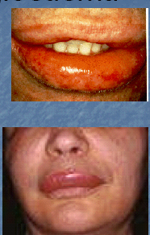
What are some of the risks involved with TNKase (Tenecteplase) Administration?
**Observe for Adverse Drug Reactions and Document Accordingly**
Hypersensitivity
      Oralingual Angioedema:
        Swelling in the mouth
        Swollen gums
        Swollen throat and/or tongue
        Difficulty swallowing
        Difficulty Breathing
If signs of hypersensitivity occurs: Notify the Physician Immediately! Be prepared to
carry out MD orders for Angioedema treatment

Slide 13
What are some of the risks involved with TNKase (Tenecteplase) Administration?
**Observe for Adverse Drug Reactions and Document Accordingly
Bleeding
      Intracranial:
          Sudden neurological deterioration
          Decline in level of consciousness
          Nausea/Vomiting
          Headache
          Worsening of preexisting symptoms already present
          Patient becomes more stuporous progressing to coma
      Ecchymosis, petechiae, abdominal and/or flank pain, hemoptysis
      Gingival oozing
      Hematemesis
      **Avoid Foley catheters, nasogastric tubes, arterial or venous catheters for at least 24 hours unless approved by treating MD or Neuro ICU Team.
      **No antiplatelet or anticoagulant agents for the first 24 hours
If signs of bleeding occurs: Notify the Physician Immediately! Be prepared to carry out MD orders for IV Thrombolytic Reversal

Slide 14
Case Study
56 yo male diagnosed with acute AIS confirmed by CT.
  The Provider has reviewed inclusion/exclusion criteria with you and has ordered TNKase (Tenecteplase).
What information would be useful before you give this medication?
Current Vital Signs & Neuro status (NIH)
Actual Weight
Ideal Weight
Where to find the consent form

Slide 15
Case Study
56 yo male diagnosed with acute AIS confirmed by CT.
  The Provider has reviewed inclusion/exclusion criteria with you and has ordered TNKase (Tenecteplase).
What information would be useful before you give this medication?
Current Vital Signs & Neuro status (NIH)
  Yes! A baseline is needed. If the BP is higher than 185/110, it will need to be treated before administering
Actual Weight
  Yes! The dosage of TNKase is based on actual weight
Ideal Weight
Ideal weight is not used. If the patient’s actual weight is more than 98 kg, the maximum dose is still 25 mg
Where to find the consent form
Written consent is not needed if the Last Known Well time is less than 4.5 hrs ago

Slide 16
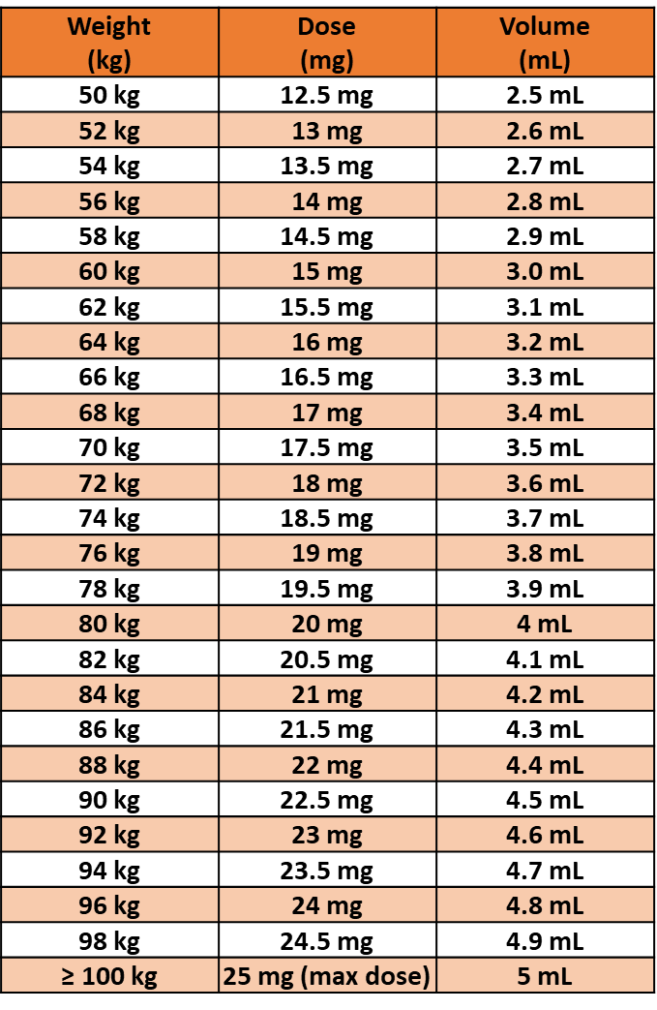
Case Study
56 yo male diagnosed with acute AIS
  The patient’s actual weight is 80 kg.
What would your next steps be?
Reconstitute TNKase (Tenecteplase) __ mg vial
with 10 mL _____ _____–
_____ _____until dissolved
Draw up __ mL (__ mg)
Confirm calculation and dosage with _____
Flush PIV with 10 mL NS
Give dose of TNKase over ___ seconds
Flush PIV with 10 mL NS
Monitor VS & Neuro status at timed intervals
Notify provider for any signs of _____ /_____

Slide 17
Case Study
56 yo male diagnosed with acute AIS
  The patient’s actual weight is 80 kg.
What would your next steps be?
Reconstitute TNKase (Tenecteplase) 50 mg vial
with 10 mL Sterile Saline –
GENTLY SWIRLING until dissolved
Draw up 4 mL (20 mg)
Confirm calculation and dosage with second RN/Pharmacist
Flush PIV with 10 mL NS
Give dose of TNKase over 5 seconds
Flush PIV with 10 mL NS
Monitor VS & Neuro status at timed intervals
Notify provider for any signs of hypersensitivity/bleeding

Slide 18
Take aways:
TNKase (Tenecteplase) will be used for Acute Ischemic Stroke (AIS) at Medical City Hospitals instead of IV Alteplase (tPA)
Written consent is not needed if used for AIS < 4.5 hrs from time of Last Known Well
Checklists are used for inclusion/exclusion criteria
Blood pressure and platelet counts can be corrected prior to and after administration
Pre-administration BP goal = less than 185/110
Dosing is weight based (0.25 mg/kg) – but maximum amount to be given is 25 mg
Medication is reconstituted with 10 mL STERILE Saline, then gently SWIRLED – never shaken.
Bolus is given over 5 seconds
Frequency of Monitoring/Documentation (VS & Neuro) - (Q15min x 2 hr, Q30min x 6 hr, Q1hr x 16 hr)
Post administration BP goal = less than 180/105
Signs of reaction (hypersensitivity/bleeding)

Slide 19
References
AHA/ASA guidelines for the Early management of patients with AIS: 2019 update to the 2018 Guidelines for the Early Management of AIS.
https://www.gene.com/patients/medicines/tnkase

