Slide 1

Core Measures
ATLAS > Rapides Top Links > Nursing Education > NU Residency EDU
2021-2022

Slide 2

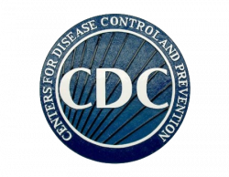

CMS is responsible for enforcing hospitals compliance of these healthcare laws (reimbursement)
TJC, has been approved by CMS, to review and report hospital compliance for accreditation/ certification
The CDC also receives every patient’s condition, treatment, and outcome, after discharge.
CDC annually reports the combined “evidenced based” research results to HSS
What are Core Measures?
Minimum Federal Healthcare Rules/Regulations (Laws), issued annually by the Department of Health & Human Services (HHS)
National Standards of Care and Treatment Processes
Evidenced Based Proven Best Practices to:
    Reduce Complications
    &
    Lead to Better Patient Outcomes
Compliance in providing each recommended treatment is:
  Publically Reported on Hospital Compare (CMS)
  Required for hospital Accreditation/Certification (TJC)
Focus: Sepsis, eVTE, and Stroke

Slide 3
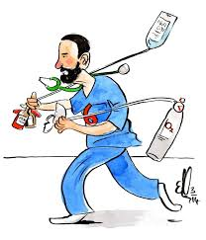
SEVERE Sepsis vs Septic SHOCK
Infection + SIRS + Organ Dysfunction Severe Sepsis plus either:
Lactate >=4 [or] Hypotension (<90 SBP or MAP <65)
*Within 3 hours of presentation REQUIRES the following SEPSIS BUNDLE!
Lactate with REFLEX (Used to evaluates effectiveness of treatment)
  Initial results >= 2 requires recollection within 4.5 hours
Blood Culture, (BC) prior to ABX administration!
  Meditech captures the time the “labeled tubes” are scanned as the time the specimen was collected!
Antibiotic, (*HCA’s Gold Standard Goal is within 1 hour)
Fluids: 30cc/kg crystalloid (LR/NS) with a Rate & DOCUMENTED fluid completion time
  ED Specific > EDM screen > Disposition > DC, TX, ADM, LPT > Document IV stop time in eMAR
Blood Pressures (BPs) [minimum x2] documented within the “1 hr following fluid completion time”
    The BPs are used to evaluate IF fluid resuscitation attempt was successful or not:
      SUCCESSFUL: either BOTH BPs ↑ [or] a ↓ BP followed by a ↑ BP
      UNSUCCESSFUL: AND REQUIRES a VASOPRESSOR!
        ↓ BP ↓ BP
        ↑ BP ↓ BP
↓ = SBP <90 or MAP <65
↑ = SBP >90 & MAP >65

Slide 4
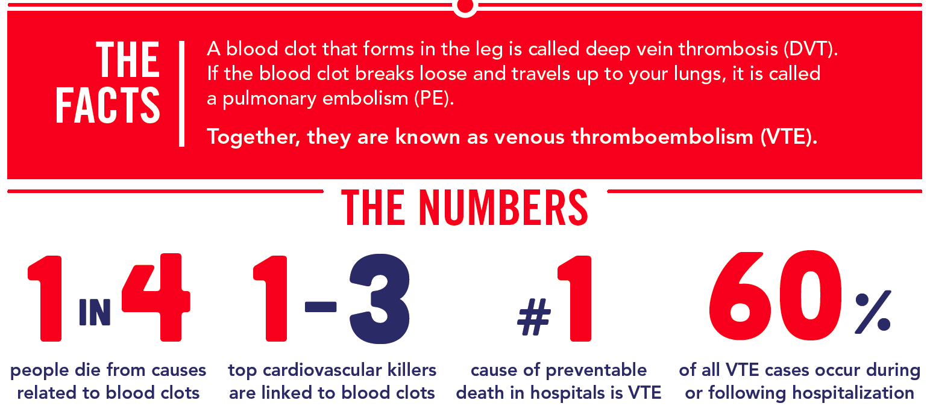
eVTE Prophylaxis Needs: Ages >=18
Prevention of Venous Thromboembolism (VTE) known as Deep Vein Thrombosis (DVT) and Pulmonary Embolism (PE)
Required Day of or Day After ADMIT
*ADMIT Date & Time through the following day at 2359*
DOCUMENT either
  Mechanical (IPC/Teds)
  Pharmacological (Medication list on slide #8)
or
CPOE order ‘zMD: VTE Prophylaxis Status’ with BOTH forms addressed
*Use this order to HOLD pharmacological prophylaxis for a procedure.
EXCEPTIONS:
ICU patients require VTE be addressed EACH transfer to the unit either Day of or Day After TRANSFER
Xarelto/Eliquis/Savaysa only acceptable for diagnosis of Current or History of Afib/flutter
  The FDA approved these medications for VTE Prophylaxis Prevention only for these patients – due to medications still in the trial period.
STK patients ≠ TED hose
*Medication List slide #8

Slide 5

STROKE Needs: (Ischemic or Hemorrhage)
Within 12 hours of ARRIVAL and prior to:
Full NIHSS within 12 hrs of arrival and/or prior to t-PA administration (even if transfer in)
Swallowing Screen prior to anything by mouth (i.e. food or medication)
Day of or Day after ARRIVAL
Antithrombotic documented in eMAR as:
  Administered
  Refused
OR
  CPOE “zMD: AntithromboticContraind” order
Day of or Day after ADMIT
eVTE Prophylaxis either:
  IPCs
  Pharmacological
  OR
  CPOE “zMD: VTE Prophylaxis Status” order with BOTH Rx/Mech contraindicated/not indicated
Required At Discharge:
MEDICATIONS:
  Antithrombotic
  Statin required for LDL > 70
  Anticoagulation Therapy for Current or Hx of Afib/flutter
    Afib/flutter patients have 5 times a higher risk of developing a Stroke and are twice as likely to die from one.
    Afib/flutter → Rapid Heartbeat → Blood pooling & clotting due to not being properly pumped out → the newly formed blood clot could break loose and travel to the brain → resulting in a Stroke.
Stroke Education
*Medication List slide #8

Slide 6
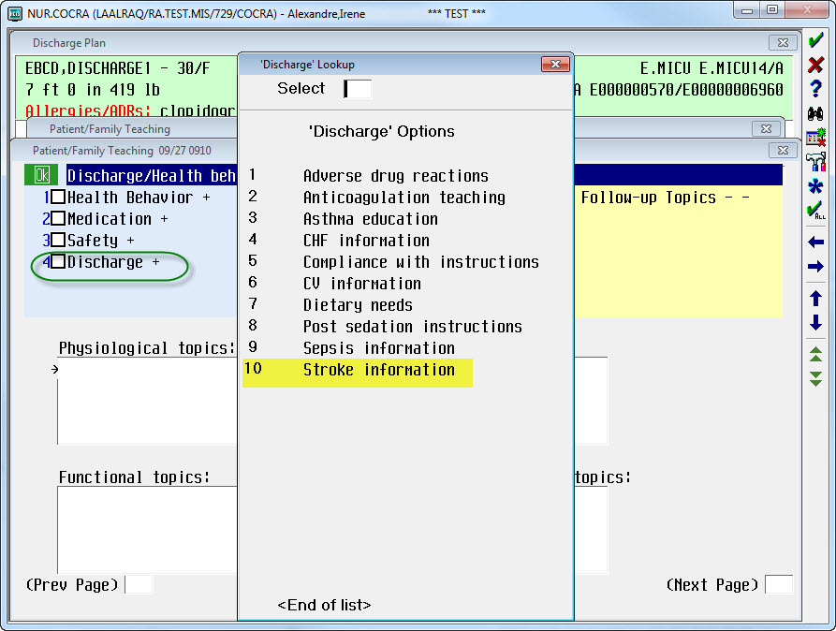
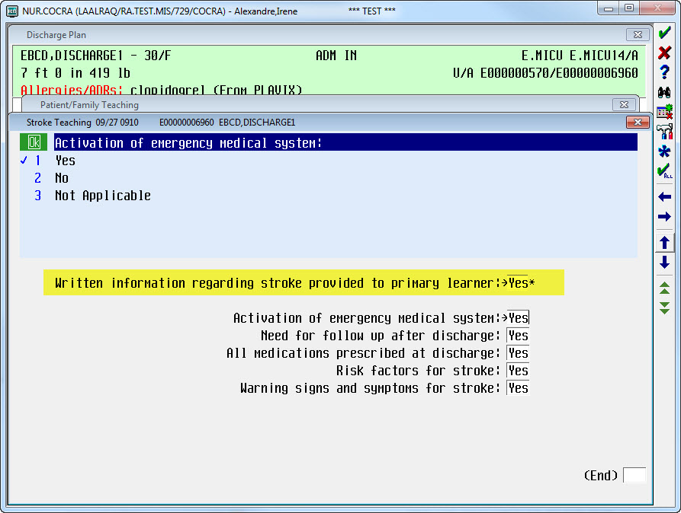
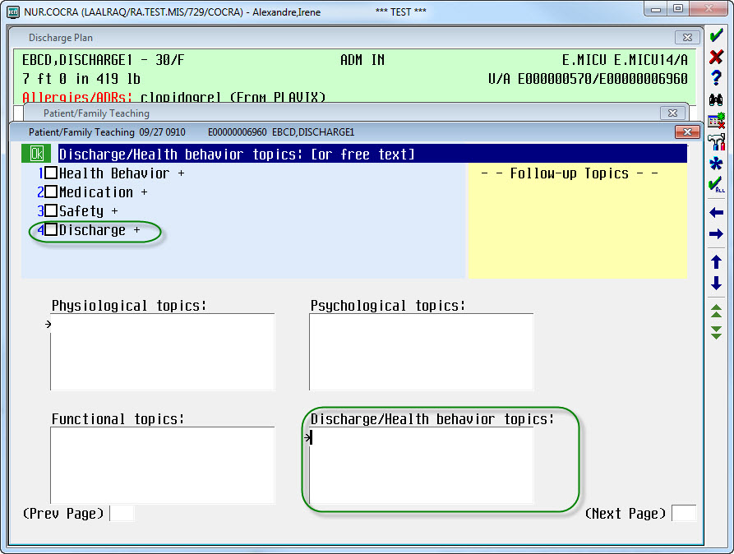
eStroke Education:
Place your cursor in the Discharge/Health Behavior topics box
Select Discharge from the list
Then select Stroke Information

Slide 7
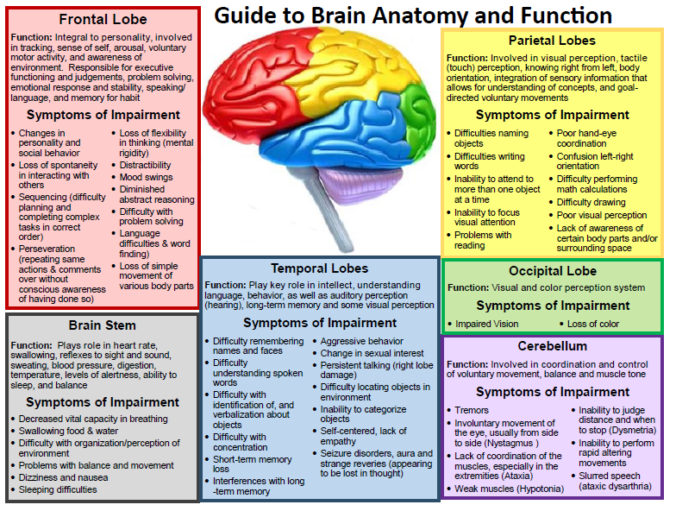

Slide 8
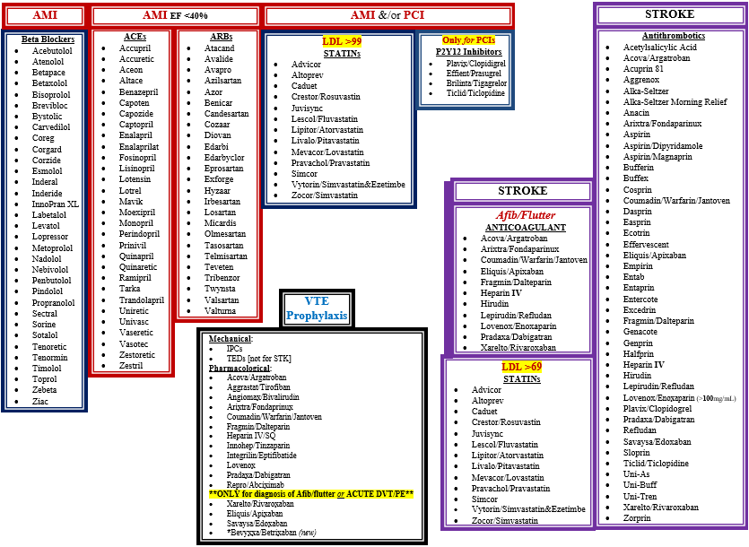

Slide 9
The NEXT SEVERAL slides are related to CPOE orders, Measure Rationales, Meditech Education, etc.

Slide 10
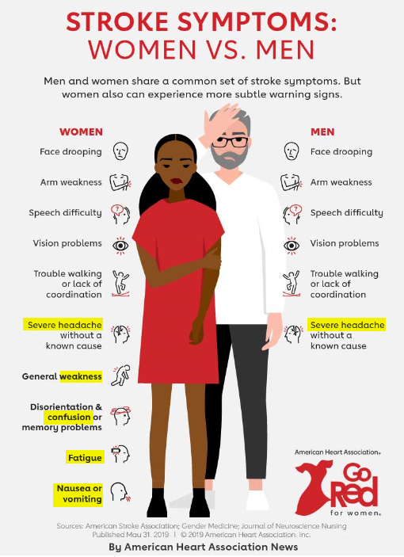
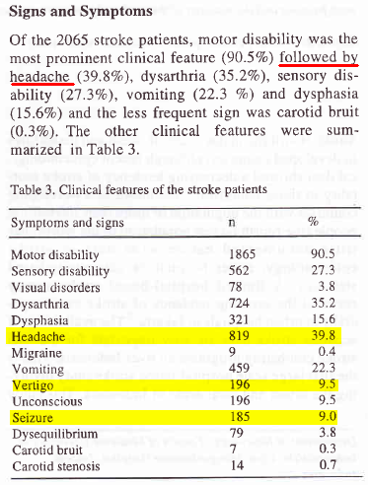
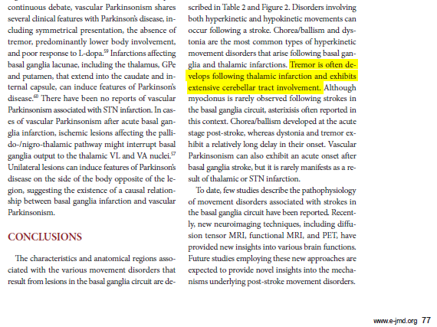
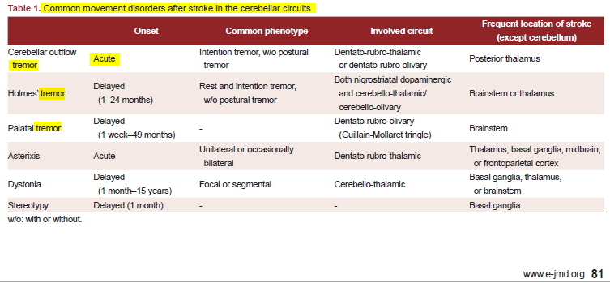

Slide 11
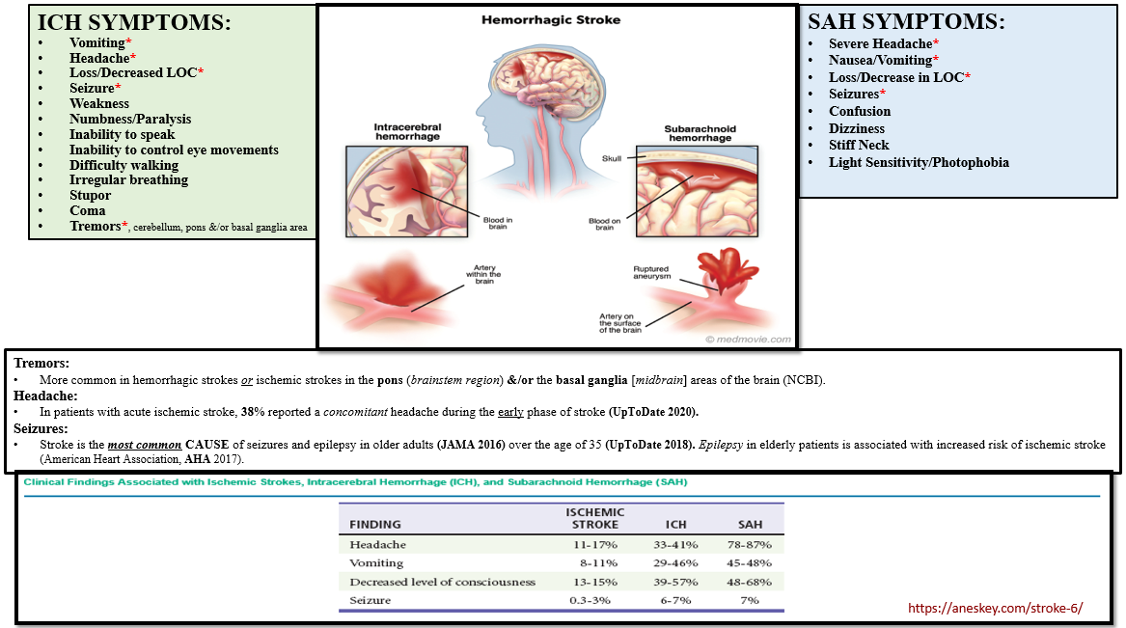

Slide 12
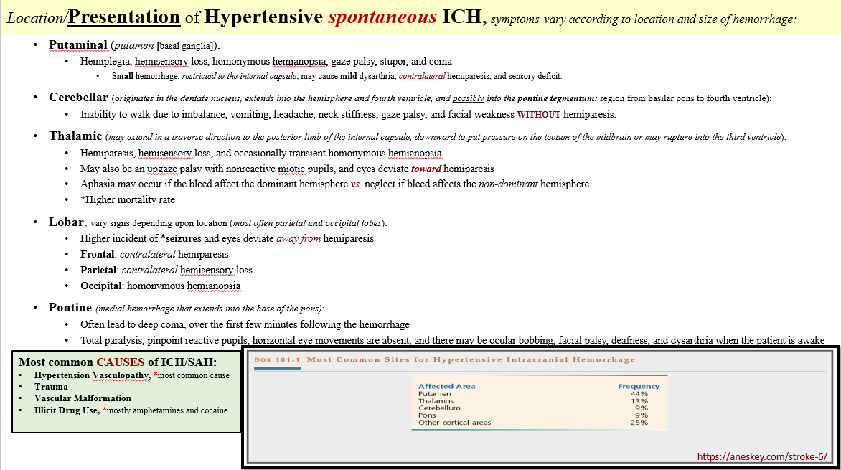

Slide 13
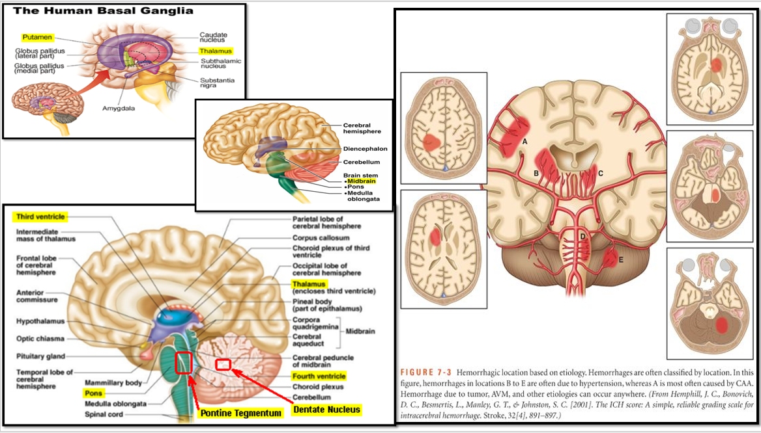

Slide 14
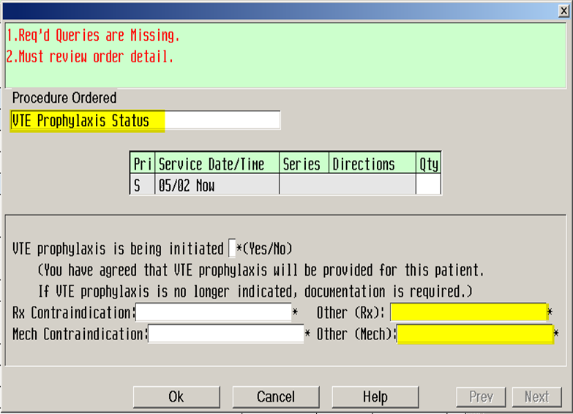
CPOE “zMD: VTE Prophylaxis Status” order

Slide 15
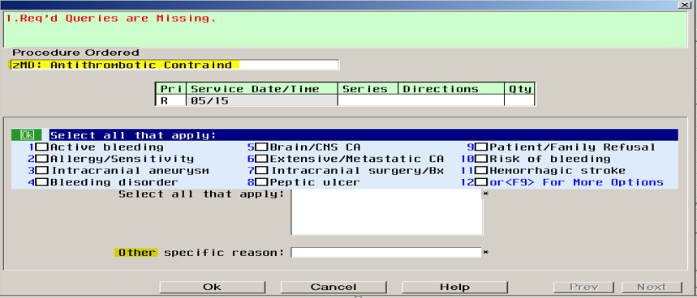
CPOE “zMD: Antithrombotic Contraind” order

Slide 16
Sepsis Measure Rationales
Initial Lactate with Reflex:
  Assess tissue perfusion, results >2 are associated with worse outcome
    LA 0.5 – 1.5: Normal
    LA >2: Hyperlactatemia, requires repeat lactate collection
    LA >4: Lactic Acidosis, most common cause of Metabolic Acidosis
Repeat Lactate:
  Evaluates effectiveness of treatment
  The initial LA level & Rate at which it falls, after treatment, are strong predictors of survival in patients with shock due to sepsis
Blood Culture prior to Antibiotic (Abx) administration:
  Better identifies causative organism
  Part of Antimicrobial Stewardship: De-escalation of antimicrobial therapy, which help prevent drug resistant bacterial infections (MRSA, E. Coli, etc.)
Broad Spectrum Abx:
  Most important facet of effective management of life-threatening infections (*Abx given <1 hr proven to decrease mortality risk by 33%)
  Most common pathogens that cause septic shock are gram-negative, gram+ and mixed bacterial organisms
IV Crystalloid Fluids [30mL/kg of NS/LR]:
  1st recommended approach to increase arterial BP in hypotensive patients
  Improves tissue perfusion by replacing intravascular fluid volume
Blood Pressures, assessed in the “1 hr” following Fluids:
  Evaluates effectiveness of fluid resuscitation (challenge)
  Recommended to assess TWICE in the “1hr” following fluid completion
    To allow the first acute stabilization of cardiac output and arterial pressure, due to cardiac output can initially increase despite minimal arterial pressure increase because of decrease in systemic vascular resistance
Persistent Hypotension, clinically evident by hypotension in the “1hr” following fluids, and requires a Vasopressor
  Vasopressors are recommended AFTER attempting fluid resuscitation
  Vasopressor adverse reactions include ventricular arrhythmias, tachycardia, angina, palpitations, cardiac conduction abnormalities, widened QRS complex, bradycardia, hypotension, hypertension, vasoconstriction, headache, anxiety, azotemia (kidney damage), dyspnea (SOB), phlebitis (vein inflammation), peripheral cyanosis, and gangrene of the extremities (risk for digital necrosis requiring amputation)
Documentation: Hospital’s self reporting of compliance in early recognition & treatment of Septic patients

Slide 17
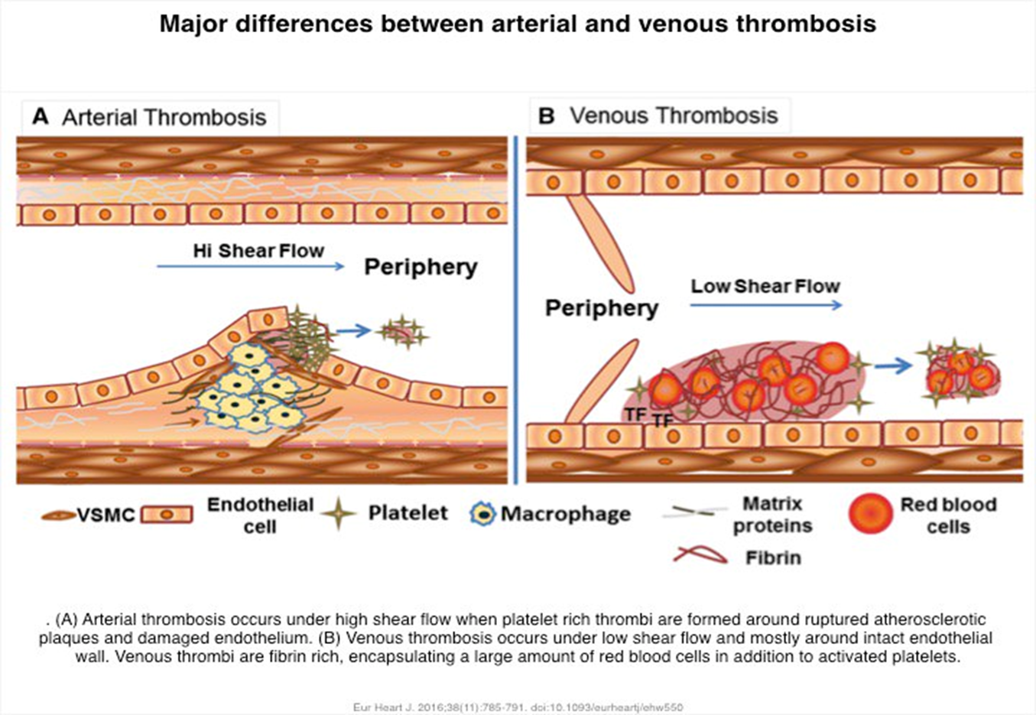
Ischemic STK & Antithrombotic(s)
ATHEROTHROMBOTIC stroke is the most common. Occurs when a blood clot forms on an atherosclerotic (i.e. fat, cholesterol) plaque within a blood vessel in the brain and blocks blood flow to that part of the brain.
Cerebral embolism happens when a wandering clot, or some other particle, called an embolus, is carried by the bloodstream. It lodges in an artery leading to or in the brain and blocks the flow of blood. The embolism could be due to a piece of clot or plaque that broke off from an atherosclerotic plaque –but – most embolic strokes are due to blood clots that form in people with Afib and enter the bloodstream.
There are x2 Antithrombotic Drug Classes (blood thinning):
  Antiplatelet: prevent platelets from clumping and also prevent clots
  from forming and growing
    Platelets stick to bumpy surfaces inside arteries; if the inner lining of the artery
    is normal, platelets do NOT cause thrombus formation
  Anticoagulant: slow down clotting, thereby reducing fibrin formation
  and preventing clots from forming and growing
    Clotting factor exist in balance with natural blood thinners and clumps when
    blood is stagnant or when unopposed by natural blood thinners
RECURRENT Strokes make up 30% of strokes that occur
  With 50% occurring within 48 hours of the initial one
  A TIA is on of the strongest predictors & accounts for 10-20% of strokes *42% of all strokes during the 30 days after a 1st TIA occurring within the first 24 hrs
Antithrombotics are recommended within 48 hours of an Initial Stroke/TIA, even prior to completion of the evaluation for ischemia, because they have been proven to reduce/decrease the risk of a recurrent/subsequent stroke by 18-37%.
  An ANTIPLATELET is recommended as a primary prevention for initial/recurrent stroke, per AHA. *Especially Aspirin [rapid onset of action (w/in 1hr) and low-cost]

Slide 18
VTE: Deep Vein Thrombosis: DVT & Pulmonary Embolus: PE
Estimated that over HALF of hospitalized medical patients are at RISK for VTE
PE, is widely believed, to be the most common PREVENTABLE cause of hospital death
VTE prophylaxis has been shown to REDUCE the RISK of VTE – but it DOES NOT eliminate the risk of VTE or VTE-related death in hospitalized patients
Age- and sex-adjusted incidence of VTE was more than 130 times greater among hospitalized patient than among community residents
  With 60% of ALL cases occurring in hospitalized, recently discharged, or nursing home patients
PE is responsible for death in up to 1/3rd of hospitalized medical patients
45% of VTE events occur within 3 months following discharge (*maybe over estimated based upon interpretation of autopsy results)
High Risk Population: ICU, Cancer with active malignancy, Stroke, Pregnancy, Old age (>75 years), Male gender >60 years, Heart Failure, MI, Renal Failure, previous VTE, prolonged Immobility, Obesity, and inherited or acquired Hypercoagulable (blood clotting) states
GCS (TEDs) were found to be ineffective in the prevention of VTE in patients with ischemic stroke

Slide 19
STK & VTE
DVT prevalence after Acute Stroke Onset:
  Symptomatic is between 1 – 10%
  Asymptomatic is even higher
DVT development may occur as early as the 2nd day after Stroke Onset
  And has a PEAK incidence between 2 to 7 days
Patients with hemiparesis (one sided weakness/paralysis) are PREDISPOSED to DVT development, and the degree of paresis confers a graded RISK of DVT
  Ipsilateral (same side) = 73%
  Contralateral (opposite) = 11%
  Bilateral = 16%
PE, often unassociated with clinically recognized DVT, accounts for:
  13 to 25% of early deaths after Stroke & IS
  The most common cause of death, at its PEAK occurrence, about 2 to 4 weeks after stroke onset

Slide 20
STK: Signs & Symptoms (S/S)
Most Common:
  Facial, Arm, or Leg: Paralysis, Tingling, Numbness, or Weakness
    Especially on one side of the body
  Changes in LOC
    Syncope [fainting, loss of consciousness], AMS, Confusion, &/or Inability/Difficulty Understanding Speech
  Difficulty Breathing, Swallowing, or Speaking (Slurred/Loss)
  Visual Changes
    Blurry Vision, Double Vision, Vision Loss, or Rapid Involuntary Eye Movement
  Vertigo/Dizziness
    Fatigue, lightheadedness, Instability, Loss of Balance, and/or Difficulty Walking
  Nausea/Vomiting
Other noteworthy S/S:
  Tremors
    More common in hemorrhagic strokes or ischemic strokes in the pons (brainstem region) &/or the basal ganglia [midbrain] areas of the brain (NCBI).
  Headache
    In patients with acute ischemic stroke, 38% reported a concomitant headache during the early phase of stroke (UpToDate 2020).
  Seizures
    Stroke is the most common CAUSE of seizures and epilepsy in older adults (JAMA 2016) over the age of 35 (UpToDate 2018). Epilepsy in elderly patients is associated with increased risk of ischemic stroke (American Heart Association, AHA 2017).
FYI: Most common CAUSES of ICH/SAH: HTN, Trauma, Vascular Malformations, and Illicit Drug Use (*mostly amphetamines and cocaine).
FYI: Both the CT &/or MRI may be NORMAL in patients with Ischemia who do not yet have brain infarction (damage to tissue due to loss of oxygen).

Slide 21
SEPTIC SHOCK & Lactic Acid
  Lactate 0.5 to 1.5 mmol = NORMAL
  Lactate >2 mmol = Hyperlactatemia
  Lactate >4 mmol = Lactic Acidosis
Increased lactate production, in part due to catecholamine stimulation of glycolysis, plays an important role in the Lactic Acidosis associated with shock, especially SEPTIC SHOCK.
  Lactic Acidosis IS the most common cause of Metabolic Acidosis, in hospitalized patients
In Sepsis, there is BOTH an ↑ in Lactate PRODUCTION, resulting from microcirculatory failure & a ↓ in Lactate CLEARANCE, that is not solely due to diminished oxygen delivery
Type A Lactic Acidosis: marked tissue hypo-perfusion, resulting from hypovolemia, cardiac failure, sepsis, or cardiopulmonary arrest.
  Clinical Manifestations of Shock, with poor prognosis unless tissue perfusion can be rapidly restored, include:
    ↓ systemic blood pressure, degree may be minimized by marked vasoconstriction
    Cool, clammy extremities, with exception of the flushed, hyperemic skin of early Septic Shock
    Oligoanuria
    Impaired Mental Status (AMS)
  BOTH the Initial LA level & RATE at which it falls, after treatment, are strong predictors of survival in patients with shock due to sepsis
Other Types of Lactic Acidosis:
  Type B: Evidence of systemic hypo-perfusion is NOT apparent, and the mechanisms that may be involved include Toxin-induced impairment of cellular metabolism and regional areas of tissue ischemia, high levels of Metformin, Malignancy-associated, Alcoholism, and Drug-induced mitochondrial dysfunction, often in HIV-infected patients.
  Type D: Unusual form of metabolic acidosis that occurs in patients with Short Bowel Syndrome, or other forms of malabsorption.

Slide 22
SEPTIC SHOCK & Hypotension
SEPTIC SHOCK: a type of vasodilatory or distributive shock and is universally DEFINED as Sepsis that has circulatory, cellular, and metabolic abnormality that are associated with a greater risk of mortality than sepsis alone (>40% vs >10%)
  Circulatory failure often manifests as hypotension (i.e. reduced tissue perfusion)
Notice there is a slight difference between this definition and the one by CMS and Healthcare Providers (MD/NP/PA).
CMS defines Septic Shock as: SIRS, Infection, & either LA >4 [or] SBP <90/MAP <65
  CMS evaluates, reimburses, and reports hospital’s compliance
  Guidelines require 30mL/kg of crystalloid fluid (NS/LR) with either a RATE or COMPLETION time
    The rate/completion time is required to review the assessed blood pressures in the “1 Hr” following fluid completion and to evaluate if the fluid resuscitation attempt was successful or not, to determine if a vasopressor is needed
  Hospital’s compliance is evaluated based on CMS’ definition of Septic Shock
    States “consistent with SSC Guidelines” and *Proven evidenced based best practice to reduce complications and lead to better patient outcomes
SCCM/ESICM/JAMA (not unanimously accepted) defines Septic Shock as: SIRS, Infection, & despite adequate fluid resuscitation, requires vasopressors to maintain a mean arterial pressure (MAP) >65 [+] LA >2
CMS = Centers of Medicare and Medicaid
Surviving Sepsis Campaign (SSC) is a joint initiative of the Society of Critical Care Medicine (SCCM) and European Society of Intensive Care Medicine (ESICM)
JAMA = Journal of American Medical Association

Slide 23
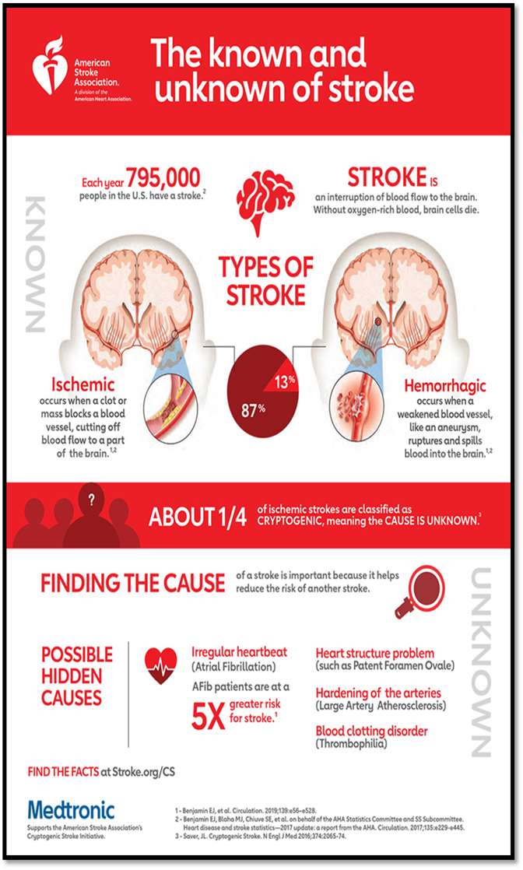
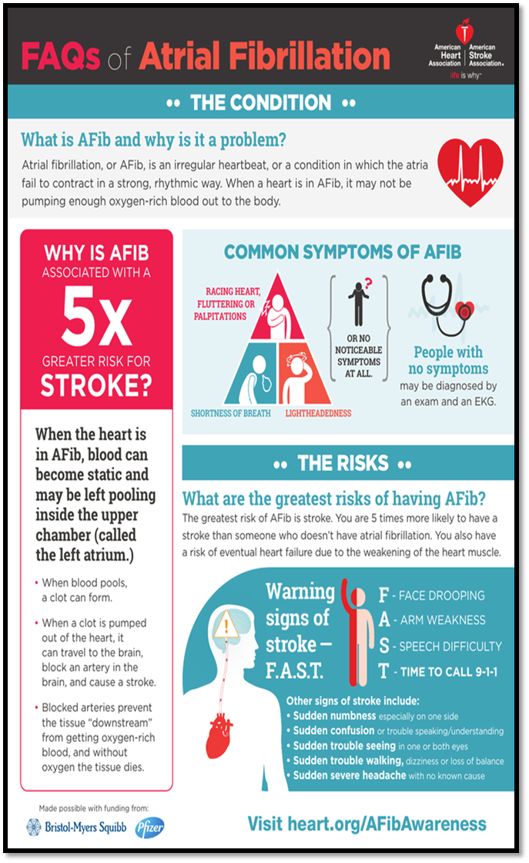
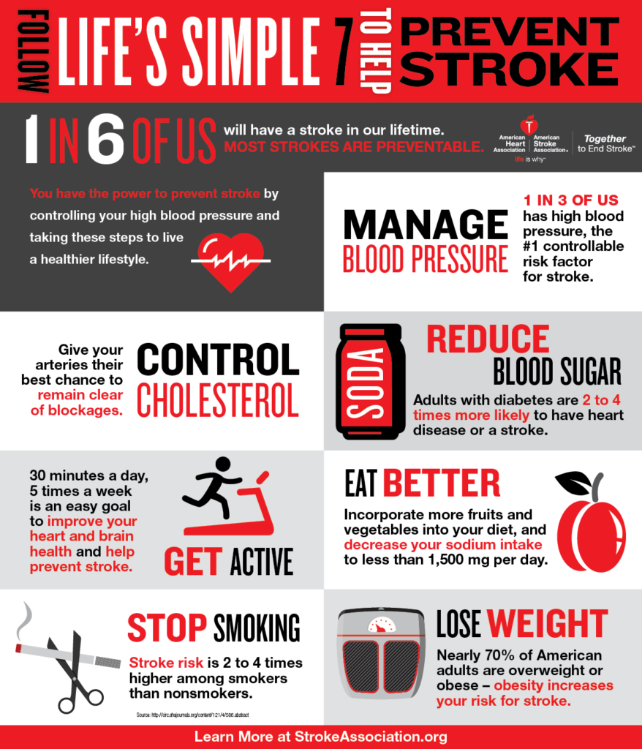

Slide 24
References:
Prevention & Treatment of VTE in STK patients
  https://www.uptodate.com/contents/prevention-and-treatment-of-venous-thromboembolism-in-patients-with-acute-stroke?search=stroke%20dvt%20risk&source=search_result&selectedTitle=2~150&usage_type=default&display_rank=2
Prevention of VTE Disease in hospitalized medical adults
  https://www.uptodate.com/contents/prevention-of-venous-thromboembolic-disease-in-acutely-ill-hospitalized-medical-adults?search=vte%20prevalence&source=search_result&selectedTitle=5~150&usage_type=default&display_rank=5
STK Pathological Process
  https://www.physio-pedia.com/Stroke
  https://www.nursingtimes.net/clinical-archive/neurology/stroke-1-definition-burden-risk-factors-and-diagnosis-16-10-2017/
Overview of secondary prevention of Ischemic Stroke – Afib/flutter
  https://www.uptodate.com/contents/overview-of-secondary-prevention-of-ischemic-stroke?search=stroke%20risk%20from%20afib&source=search_result&selectedTitle=8~150&usage_type=default&display_rank=8
Atrial Fibrillation & Risk of embolization
  https://www.uptodate.com/contents/atrial-fibrillation-risk-of-embolization?search=atrial%20fibrillation%20increases%20stroke%20risk&source=search_result&selectedTitle=3~150&usage_type=default&display_rank=3
Stroke in patients with Afib
  https://www.uptodate.com/contents/stroke-in-patients-with-atrial-fibrillation?search=atrial%20fibrilallation%20increases%20risk%20of%20ischemic%20stroke%20by&source=search_result&selectedTitle=3~150&usage_type=default&display_rank=3
Headache, Migraine, and Stroke
  https://www.uptodate.com/contents/headache-migraine-and-stroke
  https://www.ahajournals.org/doi/10.1161/STROKEAHA.113.002217
Migraine Stroke connection
  https://www.ncbi.nlm.nih.gov/pmc/articles/PMC4901947/
Stroke with Thunderclap Headache
  https://www.uptodate.com/contents/overview-of-thunderclap-headache?search=Common%20signs%20and%20symptoms%20of%20stroke&source=search_result&selectedTitle=4~150&usage_type=default&display_rank=4
Tremors & Stroke
  https://www.news-medical.net/health/Tremors-Following-Stroke.aspx
  https://www.ncbi.nlm.nih.gov/pmc/articles/PMC3468879/
Evaluation of Stroke
  https://www.uptodate.com/contents/overview-of-the-evaluation-of-stroke?search=Common%20signs%20and%20symptoms%20of%20stroke&source=search_result&selectedTitle=1~150&usage_type=default&display_rank=1
Stroke Symptom based on vascular territory
  https://www.uptodate.com/contents/image?imageKey=NEURO%2F75487&topicKey=NEURO%2F1083&search=Common%20signs%20and%20symptoms%20of%20stroke&rank=1~150&source=see_link

Slide 25
References
Stoke & Antithrombotic
  https://www.ahajournals.org/doi/epub/10.1161/CIRCULATIONAHA.118.036656
  https://www.uptodate.com/contents/antithrombotic-treatment-of-acute-ischemic-stroke-and-transient-ischemic-attack
  https://integrisok.com/-/media/pdf/stroke/gordon-antiplatelets-vs-anticoagulation-for-stroke-tia.ashx?revision=48ba6685-ff3b-4cd9-8eeb-d597619e536e&la=en&hash=5A80FD9ABC2D2B6000183A63EF8691013F0BF220
  https://www.aafp.org/afp/2012/0915/p527.html
  https://www.stroke.org/en/about-stroke/stroke-risk-factors/understanding-risky-conditions/atherosclerosis-and-stroke
Stroke location and symptoms
  https://multco.us/file/76452/download
  ttp://cerescannew.staging.wpengine.com/wp-content/uploads/2019/04/CereScan-Brain-Card-3.pdf
  https://www.researchgate.net/publication/274336601_Clinical_pattern_of_hospitalized_strokes_in_28_hospitals_in_Indonesia/fulltext/57aa4c1008ae0932c96e85d8/Clinical-pattern-of-hospitalized-strokes-in-28-hospitals-in-Indonesia.pdf?origin=publication_detail
  https://www.researchgate.net/publication/303559341_Movement_Disorders_Following_Cerebrovascular_Lesion_in_the_Basal_Ganglia_Circuit/fulltext/5a1858c4a6fdcc50ade7df9b/Movement-Disorders-Following-Cerebrovascular-Lesion-in-the-Basal-Ganglia-Circuit.pdf?origin=publication_detail
Causes of Seizures in the Elderly
  https://www.uspharmacist.com/article/causes-of-seizures-in-the-elderly
Assessing Blood Pressure after Fluid Challenge
  https://www.ncbi.nlm.nih.gov/pmc/articles/PMC3359194/
Blood Culture collection prior to Antibiotic Administration
  https://www.uptodate.com/contents/microbiology-specimen-collection-and-transport?search=blood%20culture%20collection%20prior%20to%20antibiotic&source=search_result&selectedTitle=5~150&usage_type=default&display_rank=5
Septic Shock and Elevated Lactic Acid levels
  https://www.uptodate.com/contents/causes-of-lactic-acidosis?search=sepsis%20and%20lactic%20acid&source=search_result&selectedTitle=3~150&usage_type=default&display_rank=3
Septic Shock and Hypotension
  https://www.uptodate.com/contents/sepsis-syndromes-in-adults-epidemiology-definitions-clinical-presentation-diagnosis-and-prognosis?search=septic%20shock%20and%20hypotension&sectionRank=1&usage_type=default&anchor=H8&source=machineLearning&selectedTitle=4~150&display_rank=4#H8
  https://www.uptodate.com/contents/evaluation-of-and-initial-approach-to-the-adult-patient-with-undifferentiated-hypotension-and-shock?search=hypotension%20poor%20perfusion&source=search_result&selectedTitle=2~150&usage_type=default&display_rank=2

