Slide 1
PRN Reason vs.
Pain Assessment Score eMAR admin rule
NFD IT&S
Presented by Bill Droste, PharmD
7/25/18

Slide 2
The issue:
Medications are being documented as given for parameters outside of those specified on the order
Especially notable on PRN Pain Medications
  Nurse must document the pain severity score as part of the administration.
  When the parameters on the order do not coincide with there is no notification of the mis-match
It was requested that we develop a method to “pop up” the PRN Reason during administration of pain meds

Slide 3
The proposed solution
The PRN Reason text can be displayed via a rule attached to evaluate at MAR Dose or MAR Admin
This would display to the nurse and remind to ensure the PRN Reason matched the pain assessment
But…..the nurse just completed a pain assessment (though it has not been filed yet), Let’s make use of that to provide a more meaningful alert!

Slide 4
The proposed solution
The rule developed utilizes the pain severity score entered during the assessment.
The PRN Reasons are searched for the parameters for use
  Ex) Pain Scale 7-10.
Then the pain score is compared to the range in the parameters
  If the score is within the parameters the rule allows documentation to continue
  If the score deviates from the parameters a warning is displayed

Slide 5
Disclaimers
Must use standard EBCD Pain screens and queries
Must use corporate standard PRN Reasons and formatting

Slide 6
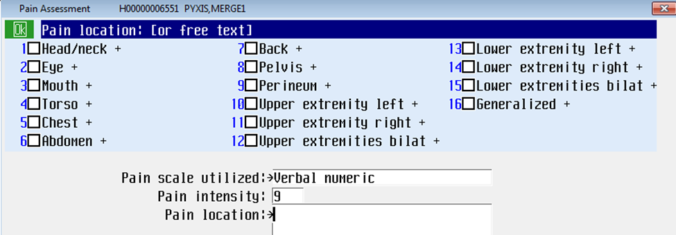
Example
Fentanyl is ordered with the PRN Reason PAIN SCALE 7-10. Nurse is documenting 9. No warning displayed.

Slide 7
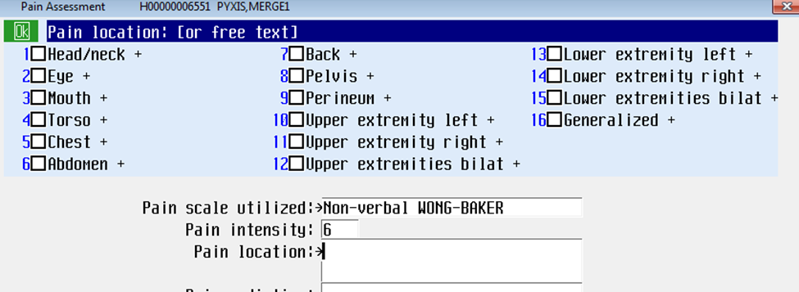
Example
This time the pain intensity is 6.

Slide 8
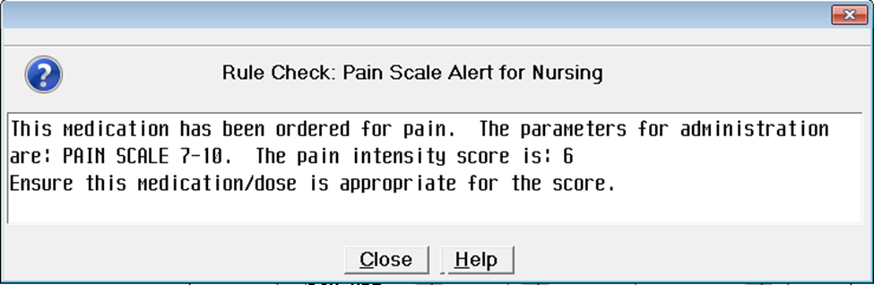
Example

Slide 9
Demonstration

Slide 10
Questions

