Slide 1
RN Market Access
For Inpatient RNs
Inpatient access to all facilities in the Denver Market
March, 2020

Slide 2
Why the change?
Nursing requests
  More efficient
    First Day Access, no extra service tickets, no extra eSAFs etc.
    Currently 100+ inpatient templates → down to one template
  Reduce Stress to nursing staff
    On first day orientation
    On floating between units and hospitals
    Same menus, same options, same hot keys
  More effective
    Streamline user menus
    Ease of use
    There are a lot of very old menus with reports and choices that no longer work

Slide 3
Please remember
You must follow the Appropriate Access Policy and access charts on a need to know basis
  You are taking care of the patient
  Audits
  Don’t access patient records that you do not need to review

Slide 4
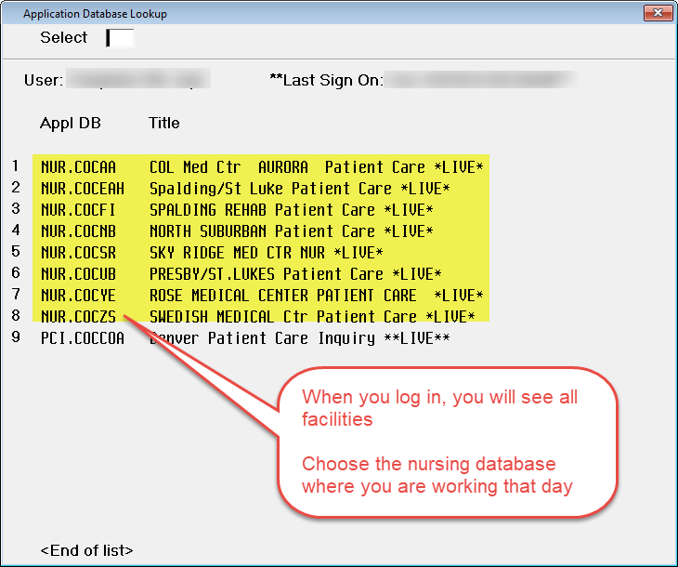
Standardization across the Division
RNs will have market access to all nursing modules
  Options will be the same across the Division (Status Board, Integrated Desktop, Magic Key menu, Print Report)
    Same order/same hot keys/same menu
  eSAF modifications will no longer be needed to add the nursing module for RNs who float to other facilities

Slide 5
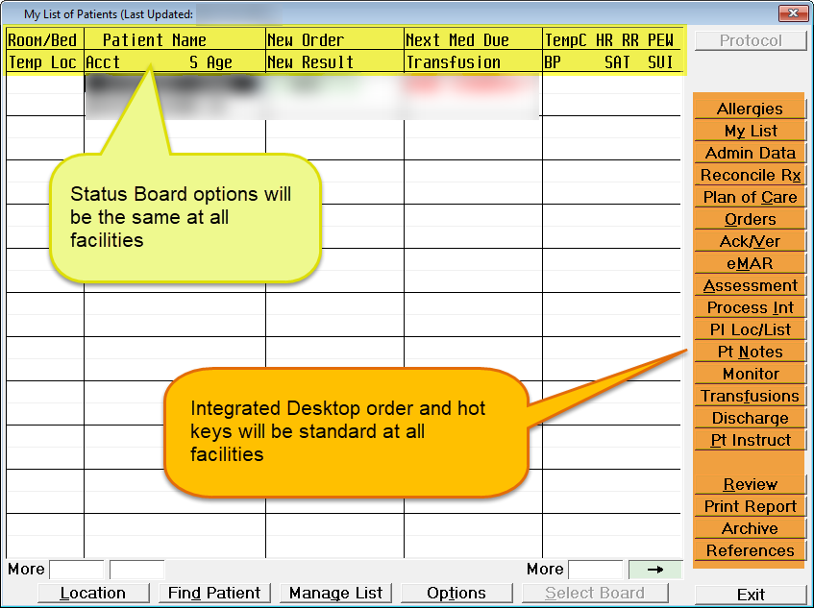
Status Board & Integrated Desktop
Status Board & Integrated Desktop will be standard across the division
  The options will be the same at all facilities

Slide 6
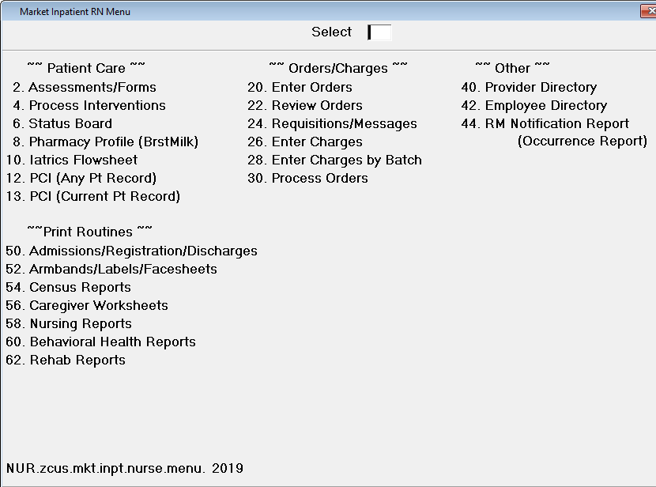
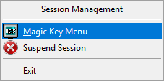
Magic Key Menu
Magic Key menu will be standard at all facilities

Slide 7
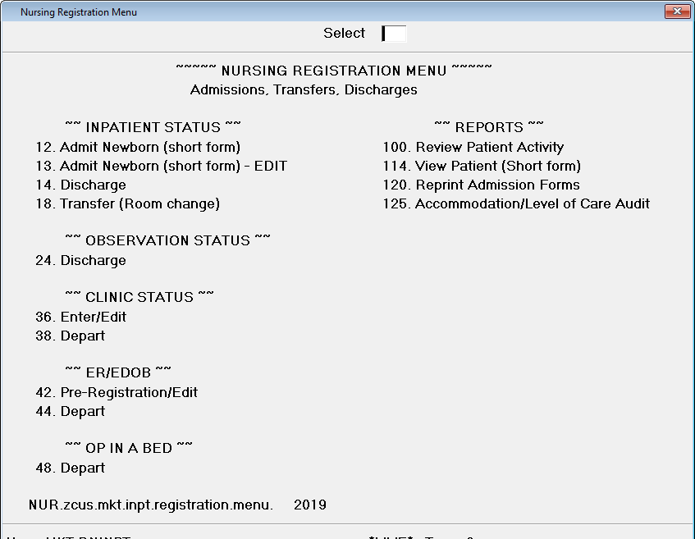
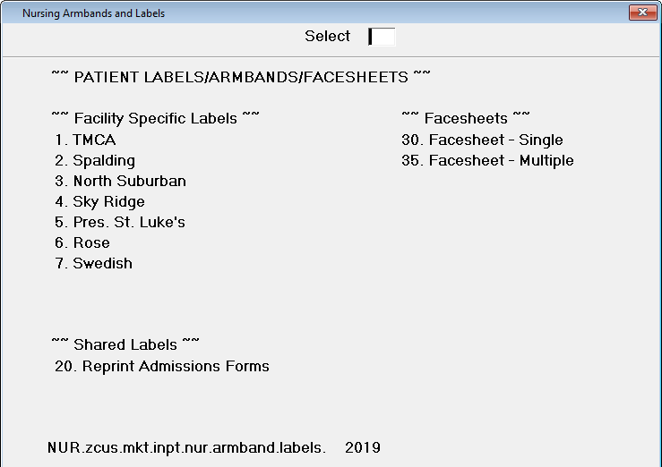
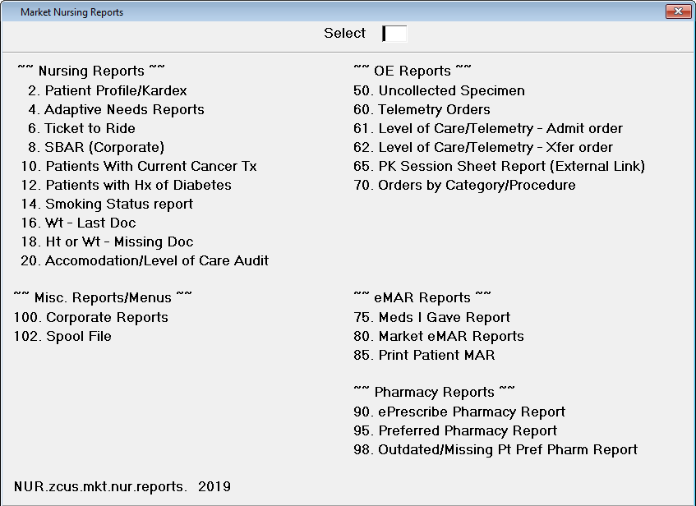
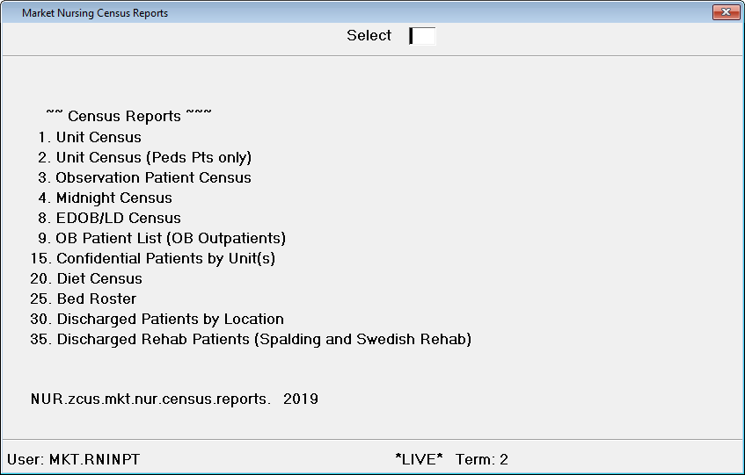
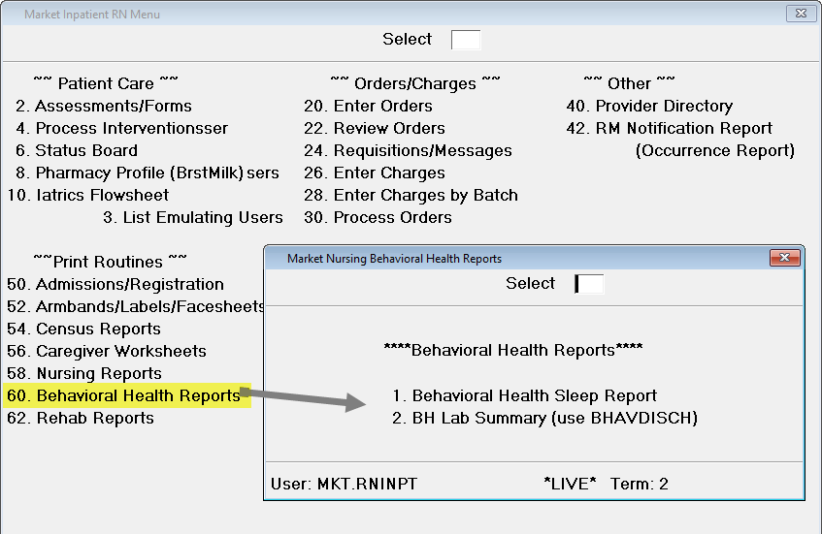
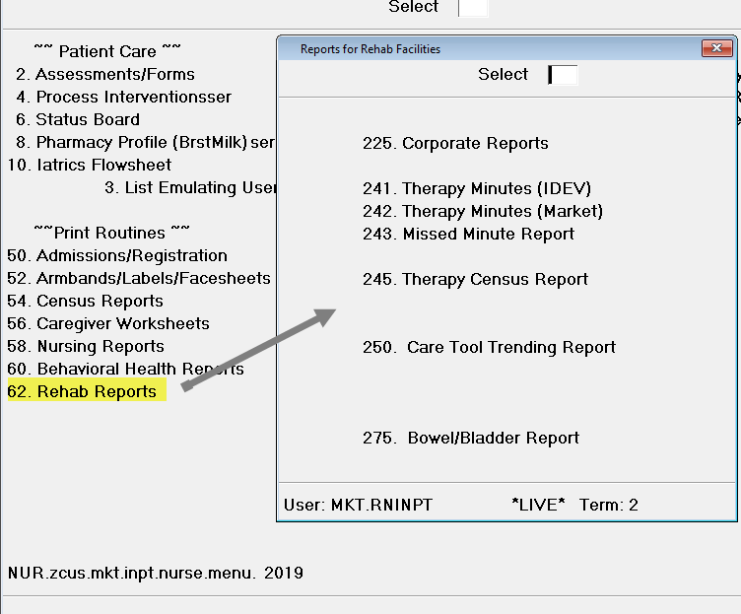
Magic Key Menu - Reports
When selecting reports, click on the facility that you logged into
Admissions/Registration
Armbands/Labels/Facesheets
Nursing Reports
Census Reports
Behavioral Health Reports
Rehab Specific Reports (Spalding)

Slide 8
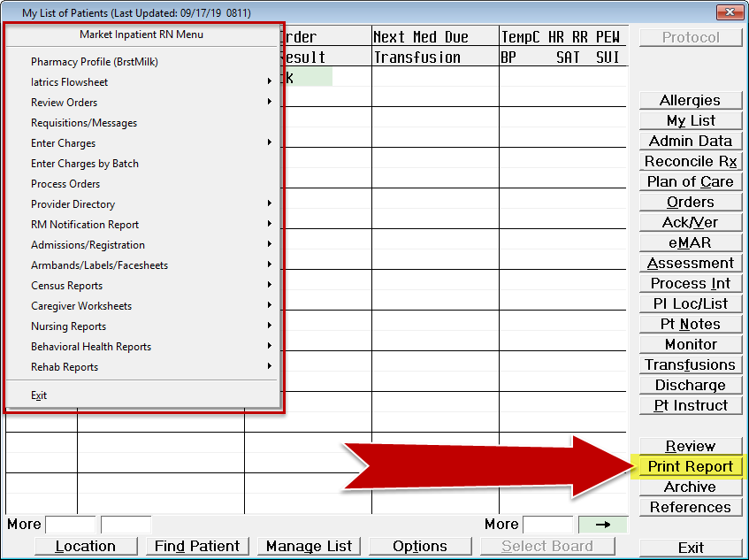
Print Report button
The Print Report button will be the new market Magic Key menu at every facility
  Mobilab, HIE, ePrescribe Transmitting Report will also be available on the Print Report button

Slide 9
Questions?
If you have any questions or need assistance, please contact your facility clinical analyst

