Slide 1

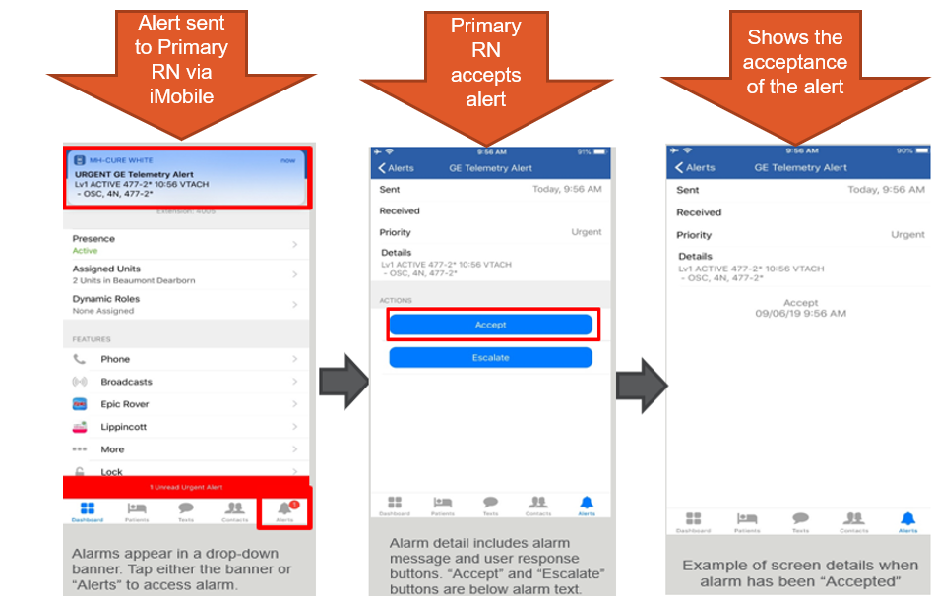
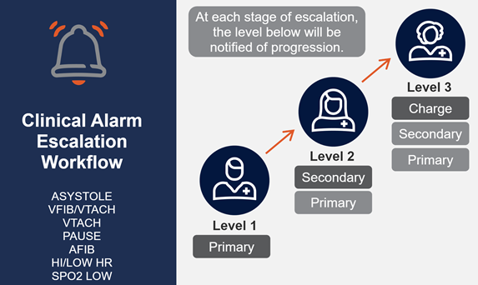
Accepting Clinical Telemetry Alerts
Using the HeART Telemetry Alert
System
Sign on to iMobile and create your assignments
by 0715/1915
HeART Telemetry Alerts are triggered on
your iMobile
Level 1 Alert – Primary RN reviews and
ACCEPTS the alert
If the level 1 alert is not accepted, the alert is
escalated to level 2
If the level 2 alert is still not accepted, the alert
is escalated to level 3
If alerts are not accepted within 30-60 seconds
based on rate or rhythm are escalated
The alert can be accepted by anyone who
receives the alert at any point in the escalation
process
Receiving a CLINICAL ALERT means that there
is a SIGNIFICANT PT EVENT, ACCEPT, &
ASSESS THE PATIENT EVEN IF YOU ARE NOT
THE PRIMARY NURSE
Technical Alerts such as change battery, leads off, no telemetry follow a similar escalation pathway. The PCT is included in alerting process.
July 2022

Slide 2
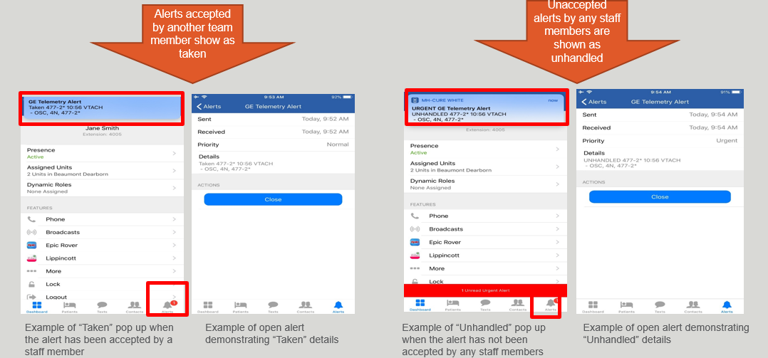
Taken and Unhandled Telemetry Alerts
If your iMobile is on silent, you will not hear alerts
Taken Alerts
When the alert accepted by another team member, the alert will show as taken on your iMobile
If you are the primary RN, review the taken alert and check your patient
Unhanded Alerts
If none of the staff on the escalation pathway accepted the alert, the alert is unhandled.
The Monitor Technician will call the appropriate medical alert overhead

