Slide 1


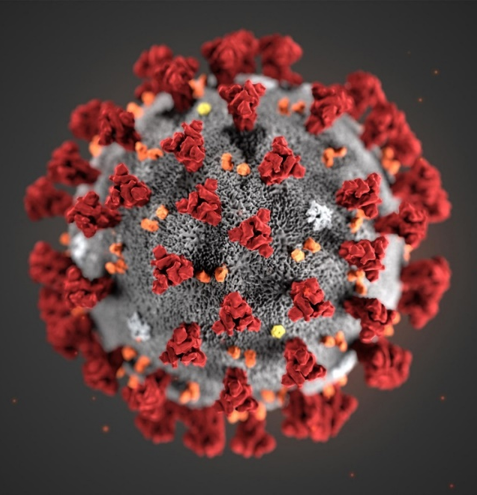
COVID-19
Personal Protective Equipment (PPE) Processes
Universal Masking, Disbursement, Extended Use, Disinfection and Reprocessing

Slide 2

COVID-19 – Understanding COVID
Role of Masks
One thing that we know about COVID-19 is that the virus is spread by droplets. At this time, the virus doesn’t appear to float in the air like pollen. It attaches itself to fluid like mucous. So preventing the spread of COVID-19 means stopping the spread of droplets – by washing hands, cleaning surfaces, and protecting faces.
That’s where masks come in. Masks are used as a BARRIER against droplets, not as a FILTER for the air. That’s good news. Because it is a lot easier to clean and disinfect a barrier than it is to change an air filter. It means that masks can be used longer to keep our caregivers safer.
We want to make sure that every caregiver has the right mask at the right time. That is why we stock three different types of masks. Different masks are used in different situations.
We’ve all become familiar with the acronym PPE, for Personal Protective Equipment. But this acronym can also be used to describe the appropriate situations for various levels of masks.
We use masks for PRECAUTION when working with caregivers and patients,
For PROTECTION from possible cases of COVID-19, and
For cases when EXPOSURE to COVID-19 droplets is highly likely.
CONFIDENTIAL – Contains proprietary information.
Not intended f or external distribution.

Slide 3
COVID-19 – Mask Types
Level 1 (Precaution)
- Staff not directly caring for suspected COVID or COVID+
- Staff who may have been exposed to COVID
- Screeners
- Visitors accompanying any patient
- Vendors or contractors
- With face shield, can be used with COVID + or suspected COVID
Level 3 (Protection)
- Protects from fluids and droplets
- Staff caring directly for suspected COVID or COVID+
- Must use with eye protection or face shield
N95 (Protection or Exposure Likely)
- Staff caring directly for suspected COVID or COVID+ based on overall supply of Level 3 vs N95
- Staff in room during or performing aerosolizing procedures
- Intubation
- Nebulizing Treatments
- Bronchoscopy
- BiPAP, CPAP, Vapotherm
- Sputum Induction
- Open Airway Suctioning
- Must use with eye protection or face shield
Reminder: Do not discard masks between patients
CONFIDENTIAL – Contains proprietary information.
Not intended f or external distribution.

Slide 4
COVID-19 – Universal Masking
Rationale
As the COVID-19 public health crisis continues to escalate rapidly and the public spread of disease becomes widespread, Insert Hospital is adapting its masking guidelines to continue to care for patients and the community while ensuring the continued protection of all patients and employees. Beginning today, Insert Hospital is implementing universal masking for all staff and providers in patient care areas. Masks will be available, but optional, for any staff in other areas that can consistently maintain social distancing of at least 6 feet.
Our ability to socially distance when providing patient care and within the workspace is limited, so we are implementing these guidelines to protect both our patients and our staff.
We are optimistic that having a universal-masking policy, and practicing effective social distancing will mean we can protect our workforce from viral spread so that they, in turn, can continue to perform critical services for patients in need and serve the community.
We also believe universal masking will not only provide a safer environment for all but also help preserve our PPE across the System.
CONFIDENTIAL – Contains proprietary information.
Not intended f or external distribution.

Slide 5
COVID-19 – Universal Masking
Guidance
Utilize a level 1 procedural mask when in the general patient care areas:
Applies to staff in the facility not requiring higher level of masks
When masks should be replaced:
  When wet, damp, or torn
  When visibly soiled
  When hard to breathe through
When masks are removed for one of the above reasons, discard in usual containers
Staff without patient contact can reuse masks for multiple days until one of the conditions above occurs.
Keep the mask on when using the restroom
During meal and water breaks:
  Utilize a disposable container to store the mask, outside surface of the mask face down on the container
Contact with the mask at any time, should be followed with hand hygiene
Minimize touching face often to manipulate position of mask if possible
CONFIDENTIAL – Contains proprietary information.
Not intended f or external distribution.

Slide 6


COVID-19
PPE Disbursement and Reprocessing Process
Centralized PPE
Location(s)
Note: Used N95 masks are stored for vendor reprocessing and eyewear are reprocessed at facilities – see facility policy
Note: All staff receive a Level I mask and appropriate PPE based on patient assignment
SCRUBS
EYEWEAR
MASKS
Medical Staff
CNC / Clinical Supervisors / Non-Clinical Dept Managers
Collect & Distribute
Employees
CONFIDENTIAL – Contains proprietary information.
Not intended f or external distribution.

Slide 7
COVID-19 – Appropriate PPE
For Patient Care Areas
COVID or Suspect COVID, ED Staff
From PPE Czar
- N95 or Level 3 mask with goggles or any face shield
Or
- Level 1 with full face shield
Plus
- Hospital Scrubs
On Unit
- Isolation Gowns
- Gloves
Patient Care Environment and EVS (Non-COVID)
From PPE Czar
Level 1 Mask
On Unit
Gloves per usual care
Respiratory Therapy and Intubation Team
From PPE Czar
- N95 mask with goggles or any face shield
Plus
- Hospital Scrubs for RT
On Unit
- Isolation Gowns
- Gloves
CONFIDENTIAL – Contains proprietary information.
Not intended f or external distribution.

Slide 8
COVID-19
PPE Disbursement - Staff
GOAL:
Process allows strict control of PPE but also ensures collection of items for reprocessing
Centralized location for PPE disbursement & collection/reprocessing (usually same site, but separated)
CNC/charge nurses, after making assignments, go to location and pick up the allotted PPE for each staff member (amount of Isolations/PUIs/Positives/other) is known prior to pick up)
Clinical Supervisors follow same process as outlined above for their respective areas (respiratory, imaging, other procedural areas, etc.) RT to receive N95 for shift.
Non-Clinical Supervisors or Designee follow same process as outlined above for their respective areas (EVS, FANS, office staff, supply chain, etc)
At end of shift, these same leaders are charged with bagging and returning the N95 masks, face shields and goggles to the centralized locations to be reprocessed or disinfected per division or facility specific process. Level 1 and Level 3 masks can be discarded at end of shift.
5. Follow facility process for storage/disposal of PPE
CONFIDENTIAL – Contains proprietary information.
Not intended f or external distribution.

Slide 9
COVID-19
PPE Disbursement - Physicians
Goal:
Process to ensure Physicians/Residents have needed PPE
All physicians/residents will present to a centralized location and receive a level one mask, if not working directly with COVID/suspected COVID patients
Physicians/residents caring for COVID/suspected COVID patients will receive appropriate PPE
Anesthesiologists and CRNAs on intubation team receive a N95 for the day
At the end of shift, physicians return ALL N95 masks and hospital issued facial protection to the designated receptacles
CONFIDENTIAL – Contains proprietary information.
Not intended f or external distribution.

Slide 10
COVID-19 – Universal Masking
Implementation Process
Supply Chain to remove all Level 1 masks from all current locations and centralize with PPE Czar
  ensure all locations assessed in addition to current PAR locations as this is a commonly used mask throughout the facility
PPE Task Force to educate additional departments on Universal Masking option and process
PPE Czar to baseline consumption of Level 1 masks
PPE Czar adjusts tracker to account for Level 1 masks and additional departments to ensure overall consumption can be tracked
  PPE Task Force to review/report out daily consumption of Level 1 to understand how mask consumption is impacted and to detect any early warning signs of a spike in use
Facility to determine how to manage staff who refuse to wear a mask
CONFIDENTIAL – Contains proprietary information.
Not intended f or external distribution.

Slide 11
COVID-19
Appendix

Slide 12
COVID-19 – N95 Disinfection Pilot
UV Light Evidence and Process – More information and toolkit to follow week of 3/30
The evidence base supporting this process:
Ultraviolet light (UV) has been shown to effectively inactivate a wide range of human pathogens including coronaviruses and other human respiratory viruses
UV has been demonstrated to inactivate human respiratory viruses, including coronaviruses (SARs COV-1, MERS COV on various models of N95
Levels of UV needed to inactive human respiratory viruses are well below the level of irradiation that would damage fit and filtration characteristics of N95s
References:
  Chun-Chieh Tseng & Chih-Shan Li (2007) Inactivation of Viruses on Surfaces by Ultraviolet Germicidal Irradiation,Journal of Occupational and Environmental Hygiene, 4:6, 400-405, DOI: 10.1080/15459620701329012
  Michael B. Lore, Brian K. Heimbuch, Teanne L. Brown, Joseph D. Wander, Steven H. Hinrichs, Effectiveness of Three Decontamination Treatments against Influenza Virus Applied to Filtering Facepiece Respirators, The Annals of Occupational Hygiene, Volume 56, Issue 1, January 2012, Pages 92–101, https://doi.org/10.1093/annhyg/mer054
  Dennis J. Viscusi, Michael S. Bergman, Benjamin C. Eimer, Ronald E. Shaffer, Evaluation of Five Decontamination Methods for Filtering Facepiece Respirators, The Annals of Occupational Hygiene, Volume 53, Issue 8, November 2009, Pages 815–827, https://doi.org/10.1093/annhyg/mep070
Continue N95 reuse process as outlined in previous PPE education.
New process for N95 reprocessing:
At the end of the shift, label the provided tag with your name, facility, and date
Place the tag on the straps of your mask
Label the brown paper bag with your name, facility and date
Brown paper bags will be collected within a plastic bin and transported to a facility for reprocessing
Masks are disinfected utilizing UV light
Disinfected masks will be placed in a clean white bag, and returned to facilities
CONFIDENTIAL – Contains proprietary information.
Not intended f or external distribution.

