Slide 1
WEST FLORIDA DIVISION CHANGE WEEK AUGUST

Slide 2
StatSeal Hemostasis Disc
Audience
Clinical Staff
Nychie Dotson, PhD, MPH, CIC, CPHQ, FAPIC
Author
Go Live Date
August 1, 2022

Slide 3
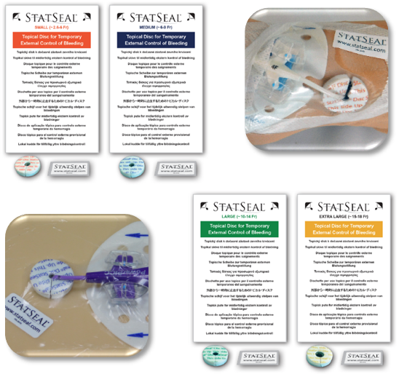
Summary of the change and why?
Adding Statseal Discs as a Topical hemostatis product for central line insertion sites experiencing bleeding complications in order to prevent dressing disruption.
Product to be stocked in POU rooms, located near central line dressing change kits. Make available in Procedure areas to include Interventional Radiology.

Slide 4
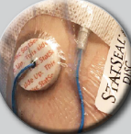
Old Way New Way
Gauze pressure dressing to assist with stopping bleeding from insertion sites
StatSeal discs used as topical hemostasis product
Within 24 hours of achieving hemostasis, remove dressing and replace with transparent antimicrobial dressing following facility protocol

Slide 5
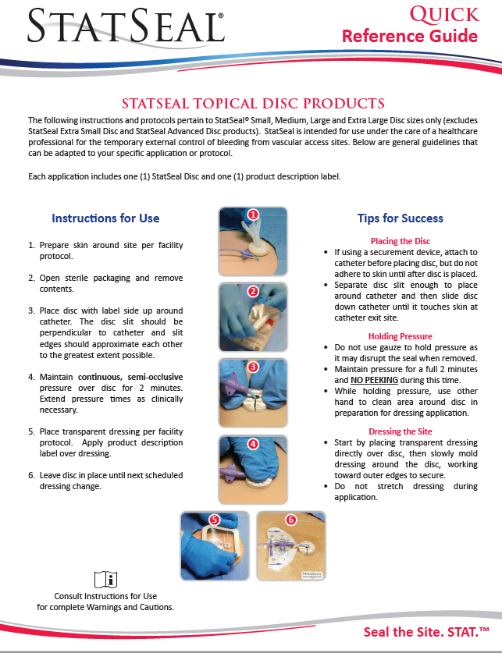
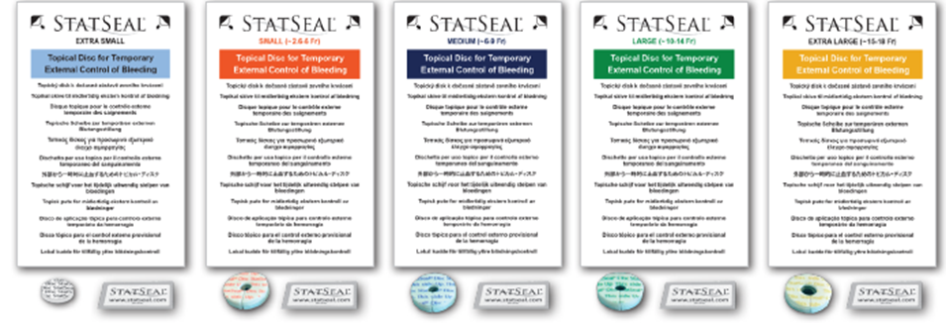
References
http://www.statseal.com/
HealthStream: West FL Statseal
hemostasis disc training 2022
Vascular Access Device, Insertion, Care and Maintenance-WFD.IC.006

Slide 6
Who to Contact for Questions
Name: Nychie Dotson
Department: Infection Prevention, WFD
Phone: 813-402-9515
Email: Nychie.Dotson@hcahealthcare.com

