Slide 1
Discharge Stroke/TIA Education Documentation
How to document Discharge Stroke/TIA Education and Patient Specific Individualized Risk Factors in Meditech

Slide 2
Why Stroke/TIA/Risk factors education is important for patients
Stroke is the fifth leading cause of death in the United States.
Some medical conditions and lifestyle choices can put anyone—regardless of gender, ethnicity, or age—at risk for stroke.
More than 50% of strokes are preventable with lifestyle changes and healthier choices.
Knowing your risk factors for stroke is the first step in preventing a stroke.
With the support of health professionals like you, your patients would better understand how to manage their risk factors like high blood pressure, high cholesterol, obesity, and diabetes to prevent reoccurrence of the Stroke/TIA.

Slide 3
Stroke/TIA risk factors
Atrial fibrillation
Carotid artery stenosis
Carotid/peripheral or other artery disease
Cigarette smoking
Diabetes mellitus
Excessive alcohol consumption
High blood pressure
Other heart disease (e.g., coronary heart disease, heart failure, dilated cardiomyopathy)
Overweight (BMI greater than or equal to 25)
Physical inactivity
Poor diet (e.g., high in saturated fat, trans fat, cholesterol or sodium)
Prior stroke, TIA or heart attack
Sickle cell disease (also called sickle cell anemia)

Slide 4
Stroke/TIA education documentation requirements in Meditech
Prior to hospital discharge, the RN must provide Stroke/TIA Education to all Stroke/TIA patients that address All of the following:
Activation of emergency medical system
Follow-up after discharge
Medications prescribed at discharge
Risk factors for stroke
Warning signs and symptoms of stroke
Stroke education MUST to be documented in All of three areas in Meditech to be compliant with TJC Stroke education measure reporting:
Teach/educate
Nursing note/canned text Stroke Education with individualized risk factors (F4/F9)
Discharge form/Patient education (Patient signature page is a part of medical record and MUST be scanned to HPF).

Slide 5
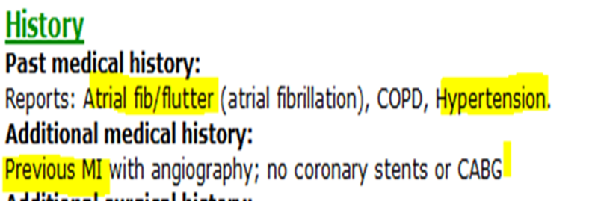
How to select Stroke/TIA risk factors
To identify what Risk factors possibly contributed to the patient’s Stroke/TIA, review PCP or Consulting physicians “Past medical history” field:

Slide 6
Step by step on how to document Discharge Stroke/TIA Education and Patient Specific Individualized Risk Factors in Meditech

Slide 7
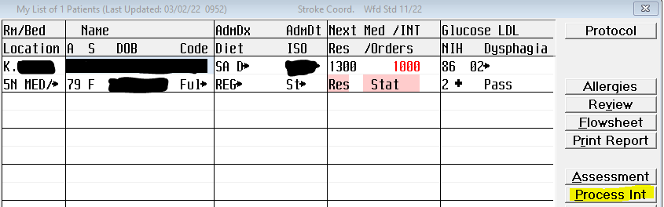
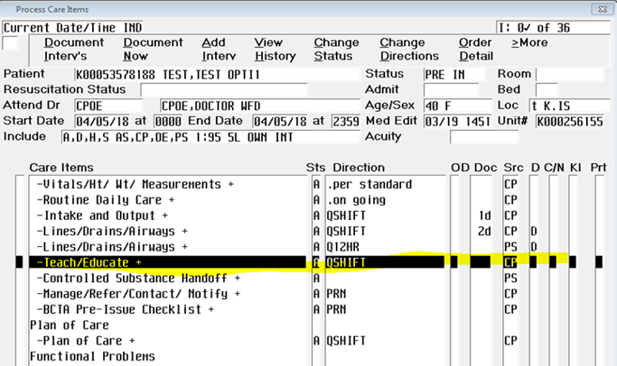
Documentation of Stroke education in Meditech
Teach/Educate field
From Status board, Select Process Intervention field
Select Teach/Educate

Slide 8
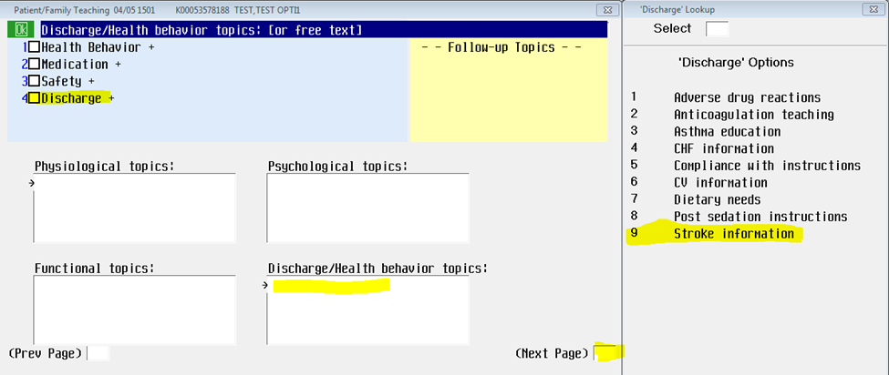
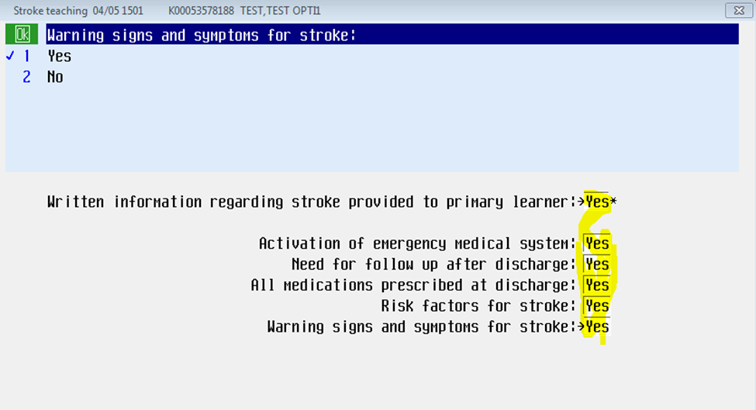
Documentation of Stroke education in Meditech
Teach/Educate field
Click Discharge/Health behavior topics field, Check Discharge and Select Stroke Information
Answer all of the fields
On the last screen Select Yes for the statement “Written information regarding stroke provided to primary learner”

Slide 9
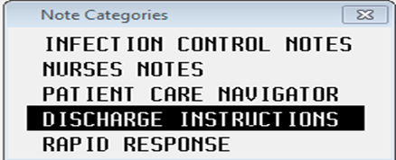
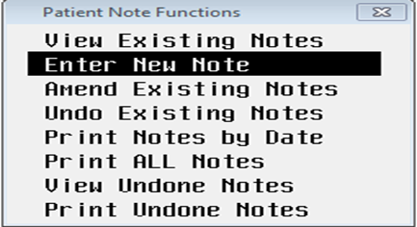
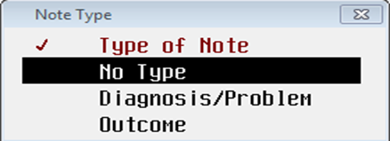
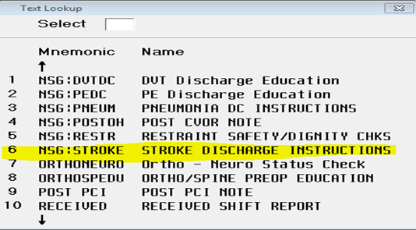
Documentation of Stroke education in Meditech Nursing note/canned text (F4/F9 key)
From the Patient Status board enter Nursing note
Select No Type
Select Discharge instructions
Select Stroke Discharge instructions

Slide 10
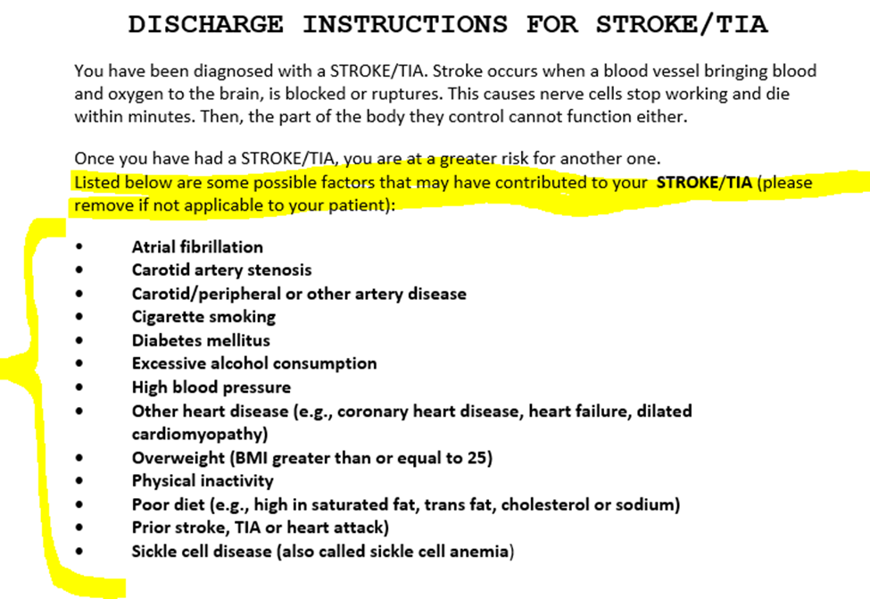
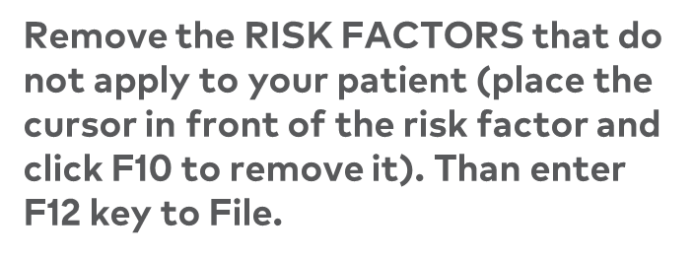
Documentation of Stroke education in Meditech Nursing note/canned text (F4/F9 key)
Move cursor to the TOP of the Discharge instruction field.

Slide 11
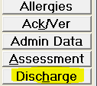
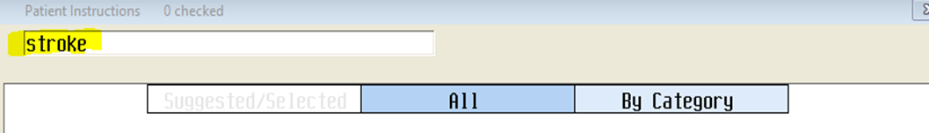
Documentation of Stroke education in Meditech
Discharge form Pt. education
Instructions | Meditech Screen
Access the discharge desktop
Click on the “Pt. Education” edit field to open up educational topics
Type “Stroke or TIA or Stroke Risk factors specific to your patient (Example: Afib, Hypertension, Smoking, Diabetes, etc.)

Slide 12
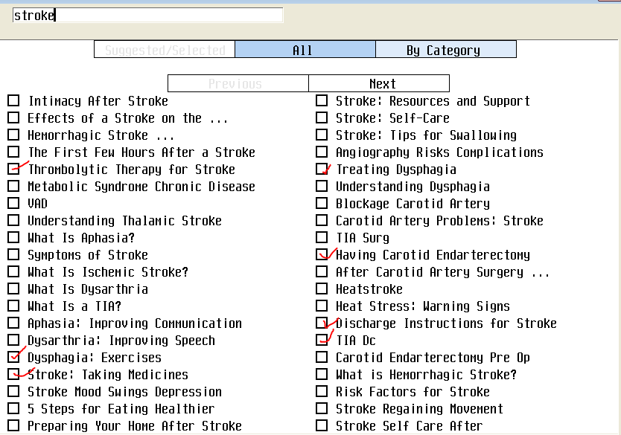
Documentation of Stroke education in Meditech
Discharge form Pt. education
Instructions | Meditech Screen
Select specific Stroke/TIA or Risk factors topics. Make sure that you print, provide and educate patient/family with all selected education prior to discharge.

Slide 13
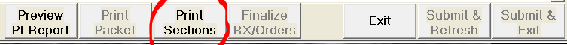
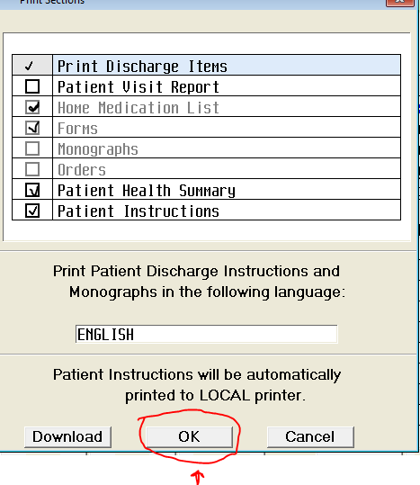
Documentation of Stroke education in Meditech
Discharge form Pt. education
To Print | Meditech Screen
Select “Print Section”
Select required fields and click “Ok” to print Home medications Forms and Patient Instructions.
Make sure that you print, provide and educate patient/family with all selected education prior to discharge. | A copy of the “Discharge Medication” and ‘Patient Discharge General Information” has to be kept as part of the medical record.

