Slide 1
Frequent Neuro Intervention

Slide 2
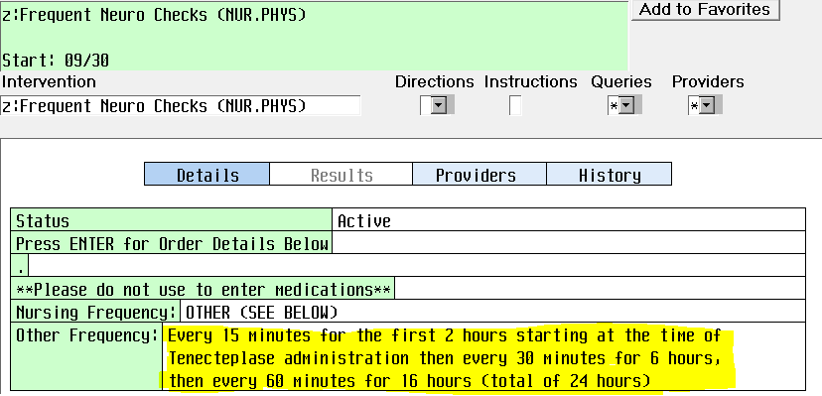
Review Physician Order for Neuro Check Frequency (post Tenecteplase only)

Slide 3
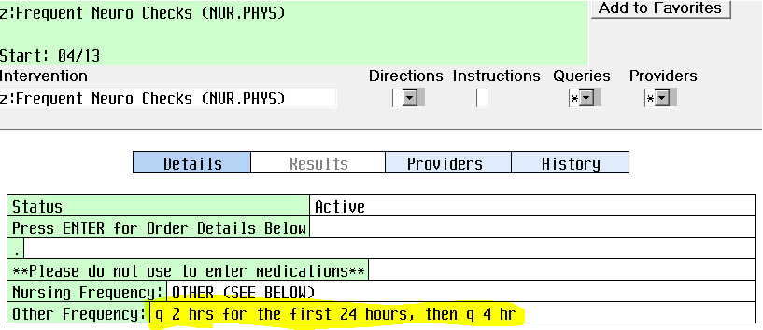
Review Physician Order for Neuro Check Frequency
If frequency is blank or order is missing, notify physician and obtain orders.

Slide 4


Step One:
Select Process Intervention Field
Step Two:
Select Frequent Neuro checks

Slide 5
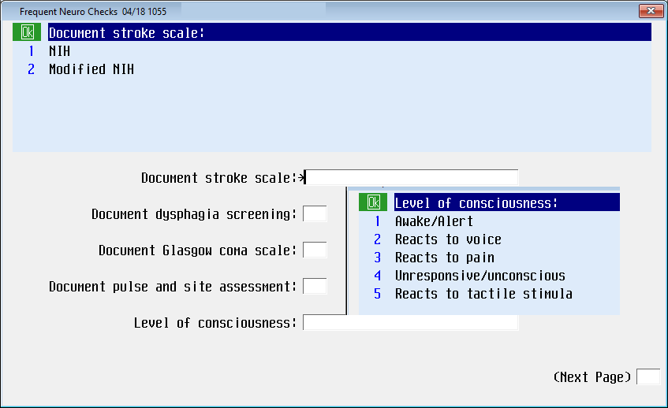
Step Three:
Complete the Next Screens 1

Slide 6
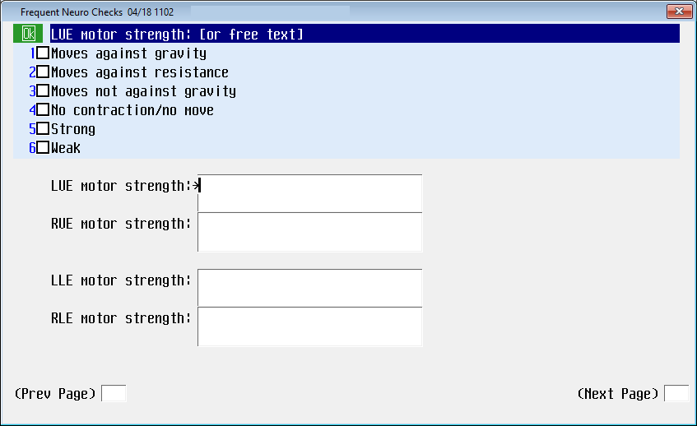
Step Three:
Complete the Next Screens 2

Slide 7
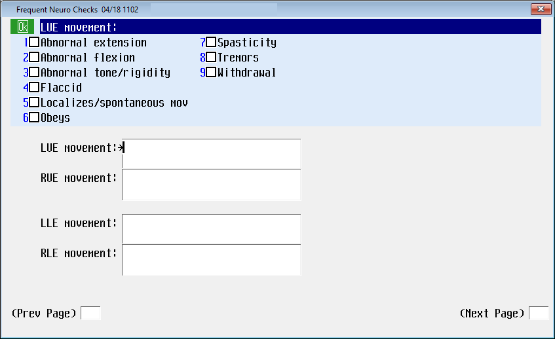
Step Three:
Complete the Next Screens 3

Slide 8
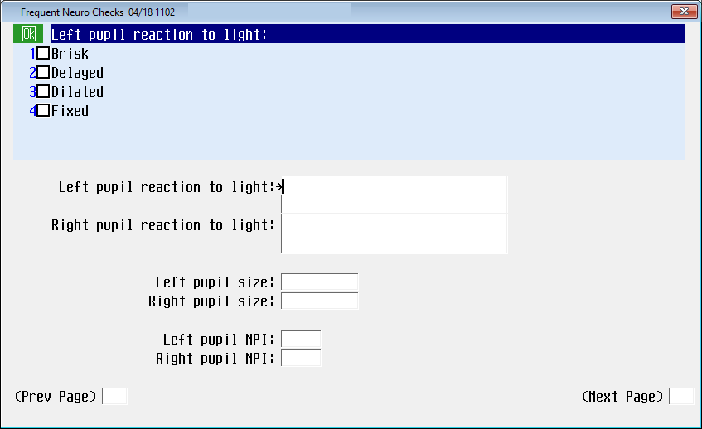
Step Three:
Complete the Next Screens 4

Slide 9
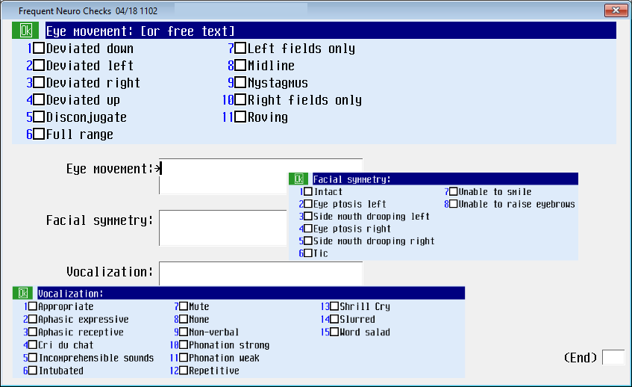
Step Three:
Complete the Next Screens 5

