Slide 1
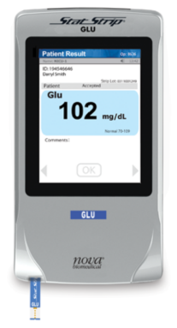

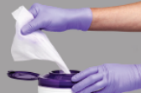
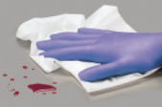
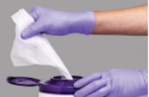
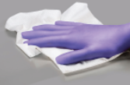
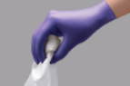





Use 2 Wipes: Clean then Disinfect
Always follow the 2-Wipe Process to Clean then Disinfect
Always Clean First…
…Then Disinfect!
Grab Wipe #1
Remove Blood
Grab Wipe #2
Disinfect Surface (Note the wet time!)
1
2
3
4
PDI Super
Discard
Discard
1
2
3
4
PDI Bleach
Discard
Discard

