Slide 1
Stroke Education
Nursing Staff

Slide 2

Oak Hill Hospital is a Primary Stroke Certified Center
What is a Primary Stroke Center Certification?
Primary Stroke Center Certification recognizes hospitals that meet standards to support better outcomes for stroke care. Eligibility standards include:
A dedicated stroke-focused program.
Staffing by qualified medical professionals trained in individualized stroke care to meet stroke patients’ needs.
Patient involvement in their hospital care.
Coordination of post-discharge patient self-care based on recommendations of the Brain Attack Coalition and guidelines published by the American Heart Association/American Stroke Association or equivalent guidelines.
Streamlined flow of patient information while protecting patient rights, security and privacy.
Collection of the hospital’s stroke-treatment performance data.
Hospital team performance data.
Use of data to assess and continually improve quality of care for stroke patients.

Slide 3
Required Standardized Measures - Goal 100%
Inpatient Stroke measures
STK-1 Venous Thromboembolism (VTE) Prophylaxis
STK-2 Discharged on Antithrombotic Therapy
STK-3 Anticoagulation Therapy for Atrial Fibrillation/Flutter
STK-4 Thrombolytic Therapy
STK-5 Antithrombotic Therapy By End of Hospital Day Two
STK-6 Discharged on Statin Medication
STK-8 Stroke Education
STK-10 Assessed for Rehabilitation
CSTK-01 National Institutes of Health Stroke Scale (NIHSS Score Performed for Ischemic Stroke Patients)

Slide 4
Hospital Clinical Care Measures
Inpatient providers utilization of “Stroke Ischemic admission” order set - Goal 90%
Stroke performance measures
Post Tenecteplase Neuro assessment - Goal 100%
24 hr Post Tenecteplase Antithrombotic tx initiation – Goal 100%
Dysphagia screen compliance- Goal 100%
Hemorrhagic bleed Blood pressure goal documentation – Goal 100%
Patient satisfaction with perception of quality of care at the program level
ED providers stroke related protocols and care of the acute stroke patient education compliance –Goal 80%.
Post Tenecteplase Blood pressure monitoring and treatment – Goal 100%
CT Brain interpretation documentation prior to Tenecteplase- goal 100%

Slide 5
Stroke Education Plan for Oakhill Hospital
Interdisciplinary team Stroke education
Role | Required Educational Hours | Frequency
PCU/Neuro-Tele Nurses | 4 hours | Annually, NIHSS
Clinical Nurses (all nursing units) | 2 hours | Annually, NIHSS

Slide 6
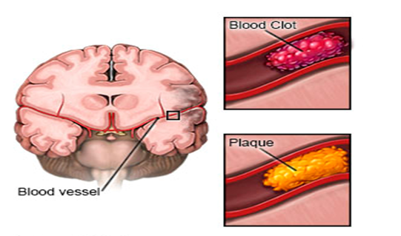
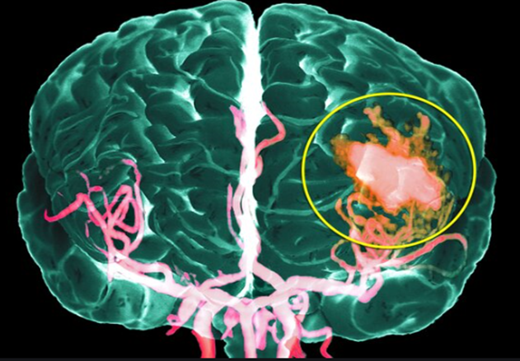
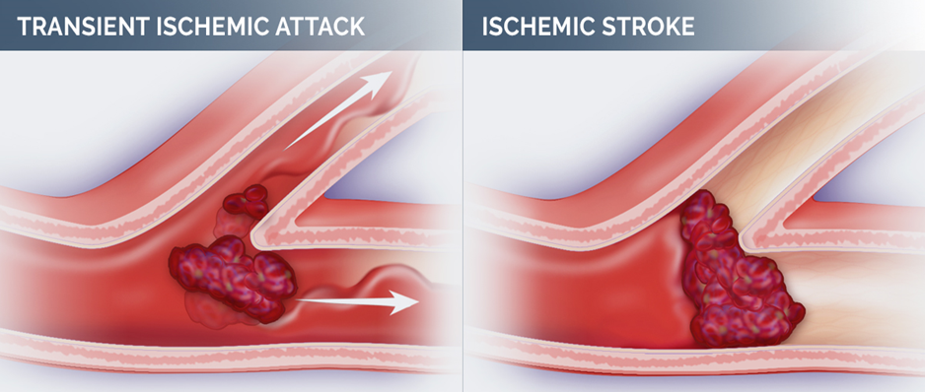
Types of Stroke
Ischemic Stroke
87% of strokes (most) are Ischemic strokes
  Thrombotic stroke
  Embolic stroke
Posterior Circulation Stroke (Dizziness-47%)
Cryptogenic Stroke (PFO, Paroxysmal A-fib, Thrombophilia, Aortic Arch Atheroma)
Hemorrhagic Strokes
13% of strokes are Hemorrhagic
  Intracerebral hemorrhages
  Subarachnoid hemorrhages
Transient Ischemic Attack (TIA)
Most symptoms of a TIA disappear within an hour, although they may persist for up to 24-hours

Slide 7
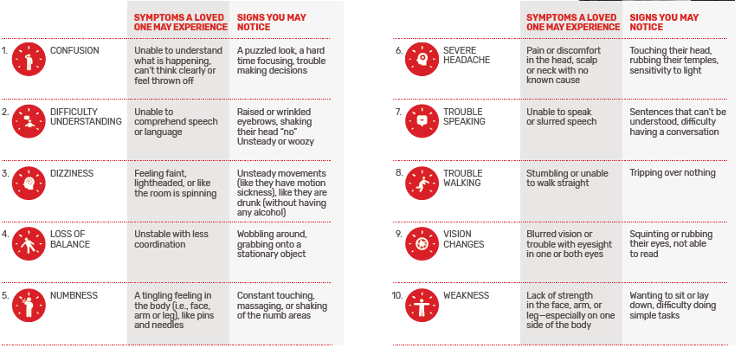
10 Signs and Symptoms of Ischemic Stroke
Ischemic Stroke - occurs when a clot or a mass blocks a blood vessel, cutting off blood flow to a part of the brain.

Slide 8
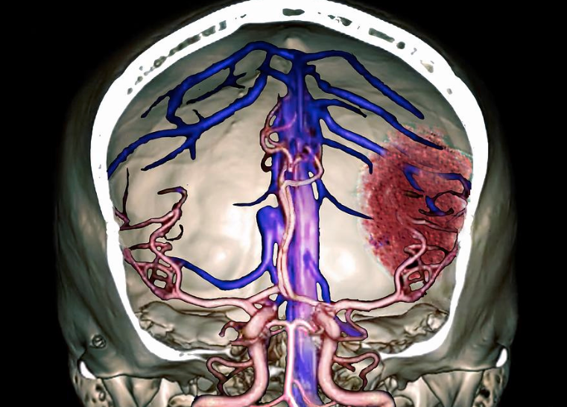
Signs and Symptoms of Hemorrhagic Stroke
Hemorrhagic Stroke - occurs when an artery in the brain bursts, blood pools within the brain tissue. This is toxic for the brain tissue causing the cells in that area to weaken and die.
Sudden severe Headache
Vision changes
Loss of balance or coordination
Becoming unable to move
Numbness in an arm or leg
Seizures
Loss of speech or difficulty understanding speech
Confusion and loss of alertness
Nausea and vomiting
Loss of consciousness

Slide 9
When to Activate a Stroke Alert?
A Stroke Alert is called when a patient demonstrates one of the following signs of stroke, causing measurable neurologic deficit and was last seen normal 24 hours or less prior to calling the event, or awakens with stroke symptoms:
Sudden numbness or weakness of the face, arm or leg, especially on one side of the body.
Sudden confusion, trouble speaking or understanding.
Sudden vision changes (trouble seeing in one or both eyes).
Sudden changes in balance and coordination- walking, dizziness.
Sudden severe headache (with no apparent cause).
Syncope.
Seizure.

Slide 10
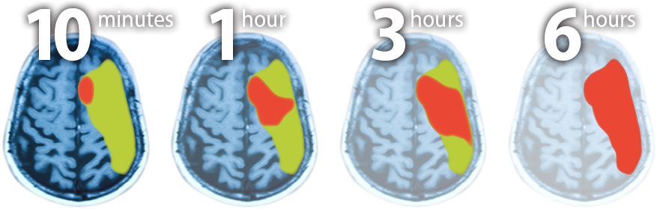
Stroke Alert
Who can initiate a Stroke Alert?
Anyone (Physicians, Nurses, PCT, Greeters, Residents, family, employees, etc.) in the hospital can initiate a Stroke Alert.
How to initiate Stroke Alert?
Dial *31999
Time is Brain

Slide 11
Stroke Teams
Inpatient Stroke Alert Team:
Primary Nurse
ICU nurse or House Supervisor or Rapid Response nurse
Senior ICU resident (Intensivist between 12 pm- 1 pm)
Laboratory phlebotomist
Radiology and Computerized Tomography (CT) Tech
Radiologist
Tele-Neurologist on call

Slide 12
Inpatient Stroke Alert Communication Process
The primary nurse will communicate to the Senior ICU resident (Intensivist between 12 pm- 1 pm) and Tele-Neurologist:
Arrival time
Patient name/date of birth
Last known well date/time
Chief complaint/symptoms
VS (B/P and poc Glucose)
Medical history:
  Any recent Bleeding (brain, rectal, urine, etc.)
  Any Blood thinners and when taken (Coumadin, NOAs)
  Any Stroke (recent in the past three month)
  Any Surgery (recent surgery)

Slide 13
Stroke Alert Process Steps
Inpatient Patient Exhibits S/S of Stroke | Responsible
Initiate Stroke Alert *31999 | Anyone can initiate Stroke Alert
Inpatient Stroke Alert Team at bedside
Stroke Alert order sets initiated | Senior ICU resident (Intensivist between 12 pm- 1 pm)
BP and poc Glucose taken (If BP elevated, Senior ICU resident (Intensivist between 12 pm- 1 pm) notified ASAP) | Primary RN or designee
BP treatment initiated, if needed | Primary RN or designee
Blood drawn and taken to LAB, if needed | LAB phlebotomist
Tele-neurology e-notification | Charge nurse
Patient taken to CT scan, Tele-neuro cart taken to CT | ICU RN or Rapid response nurse and Primary RN
Patient placed on weighed stretcher and taken to PIT stop for Tele-neuro evaluation
IV site, patient’s weight in kg
Tenecteplase given, if indicated | ICU RN or Rapid Response nurse
Patient taken for CTA/CTP Head/neck, if indicated
Dysphasia screen | Primary RN
If LVO suspected, initiate prompt transfer

Slide 14
Stroke/TIA Patient Requirements
Nursing Care | Frequency
VS and neuro assessments | Q2 hours x 24-hr., then Q4 hours.
NIHSS | On arrival, Q shift , at any neurological change and prior to discharge
Keep BP under 220/120 mmHg | If BP above those parameters, notify provider immediately
Dysphasia screen | Completed prior to first PO medication. If “Fail”, notify provider and keep NPO
Antithrombotic medication | Day of arrival considered Day 1. Expect order for an antithrombotic therapy on all Stroke/TIA patients. Call MD and ask for antithrombotic medication order if one has not been prescribed. NPO is not a reason for not administering antithrombotic therapy.
VTE prophylaxis | Documented Q shift or VTE contraindication order documented by the end of hospital day two.
PT/OT/ST eval | Expect orders for PT/OT/ST evaluation on all Stroke/TIA patients. If you do not see orders, call MD to obtain one. Prior to hospital discharge, the patient has to be evaluated by Rehabilitation therapy department or Rehabilitation tx contraindication exclusion order needed prior to discharge.
Discharged on Anticoagulation Therapy for A-Fib/A-flutter, History of A-fib/A-flutter | Prior to hospital discharge, the RN must make sure anticoagulation therapy was prescribed for patients with documented A-fib/A-flutter or History of A-fib/A-flutter. Discuss with MD if there is no order for anticoagulation therapy at discharge. If anticoagulation is contraindicated, an “Anticoagulation contraindication” exclusion order needed prior to discharge.

Slide 15
Stroke/TIA Patient Requirements Cont’d.
Nursing Care | Frequency
Discharged on Antithrombotic Therapy | Prior to hospital discharge, the RN should assess the patient’s discharge medications to ensure antithrombotic therapy has been prescribed. Discuss with MD if there is no order for antithrombotic therapy at discharge. If antithrombotic is contraindicated, an “Antithrombotic contraindication” exclusion order needed prior to discharge.
Discharged on Statin Medication | Prior to hospital discharge, the RN should assess the patient’s discharge medications to ensure Statin therapy has been prescribed. Discuss with MD if there is no order for Statin therapy at discharge. If Statin is contraindicated, an “Statin contraindication” exclusion order needed prior to discharge.
Stroke/TIA Education | Prior to hospital discharge, the RN must provide printed Stroke/TIA Education to all Stroke/TIA patients. During discharge timeout process, make sure that individualized Risk factors selected on the Stroke/TIA Discharge Instructions as well as Stroke Education using EBCD Teach/Educate module and printed Stroke/TIA related education provided to the patient.

Slide 16
Stroke Care Elements

Slide 17
Last Known Well vs. Onset of Symptoms
Definition:
The primary nurse must be able to recognize neurological symptoms that suggest stroke and rapidly assess the initial time of symptom onset or the last known well time
Last Known Well: The time at which the patient was last known to be without the signs and symptoms of the current stroke or at his or her prior baseline.
Onset of symptoms: the first appearance of the signs or symptoms of an illness.
Rationale:
Knowing Last Known Well, in the person that having a Stroke symptoms, is very important.
Every minute that we wait, 2 million brain cells die.
Last known well (date/time) will help Physicians/Providers to determine if patient is appropriate for the Tenecteplase treatment.
There a three-hour window from the symptoms onset to the time Tenecteplase therapy can be administered safely.
Studies have shown that prompt thrombolytic therapy with intravenous Tenecteplase reduces disability after acute ischemic stroke.

Slide 18
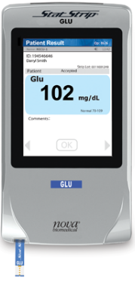
Assessment of Blood Glucose for Stroke Patients
Definition:
As per The Joint Commission requirements specific to Primary Stroke Certified Center, a blood glucose level must be completed for any patient presenting with stroke symptoms.
POC testing is a widely used tool to enable immediate determination of glucose levels in hospitalized patients and facilitate rapid treatment decisions
Rationale:
The brain uses glucose. Different brain regions have different metabolic demands. Focal deficits may be a result of asymmetric distribution of glucose in the brain.
The most important test in emergency stroke evaluation is glucose, because levels of blood glucose, which are too high or too low, can cause symptoms that may be mistaken for stroke.
Low blood glucose (hypoglycemia) is well known to produce a stroke-like picture with hemiplegia and aphasia.
Elevated blood glucose (hyperglycemia) at the time of acute stroke increases the risk of hemorrhagic transformation with Tenecteplase treatment.
Hyperglycemia may accelerate tissue infarction and may impair thrombolysis and reperfusion.
The early glycemic control with insulin in combination with Tenecteplase significantly reduced the brain infarction, brain swelling and the Tenecteplase induced hemorrhage.
Misdiagnosis and improper treatment of hyperglycemia could worsen the clinical outcomes in acute stroke patient and have higher 30- day mortality rate.

Slide 19
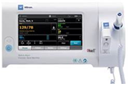
Assessment and Management of Blood Pressure is Important
Definition:
As per 2019 Guidelines for the Early Management of Patients with Acute Ischemic Stroke, the blood pressure (BP) level should be maintained in patients with acute ischemic stroke to ensure best outcome.
Blood pressure is the force of circulating blood on the walls of the arteries.
Blood pressure goal for treatment of Ischemic Stroke: Guidelines suggest withholding antihypertensive agents in Stroke patients unless the DBP is >120 mm Hg or the SBP is >220 mm Hg and limiting the drop in BP during the first 24 hours by approximately 15%
Rationale:
Hypertension is a major modifiable risk factor for stroke, with an estimated 51% of stroke deaths being attributable to high systolic blood pressure globally.
More than 60% of patients with acute ischemic stroke present with elevated BP within 1 hour of symptom onset.
Lowering BP reduces the risk of stroke.
Hypotension and hypovolemia should be corrected to maintain systemic perfusion levels necessary to support organ function.

Slide 20
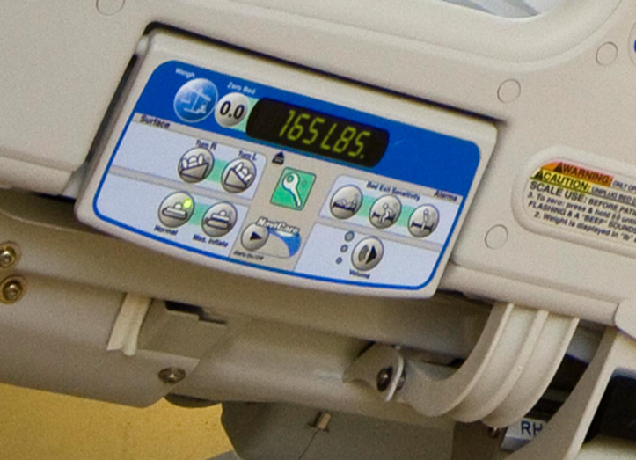
Obtaining an Accurate Weight is Important Prior to Giving Tenecteplase
Definition:
Why is patient weight important?
A patient's weight is important information because it is often used to calculate the appropriate medication dose. When medication errors arise due to inaccurate or unknown patient weights, the dose of a prescribed medication could be significantly different from what is appropriate.
Rationale:
When Acute Ischemic stroke strikes, every minute counts.
Ischemic stroke accounts for about 87 percent of all cases.
Every minute that we wait, 2 million brain cells die.
IV Tissue Plasminogen Activator (Tenecteplase) is the most important acute treatment for the vast majority of ischemic stroke patients.
The dosage of tissue plasminogen activator (Tenecteplase) depends on the patient’s weight in kilograms.
Under dosing or overdosing with Tenecteplase may result in incomplete recanalization (the reopening of a previously occluded passageway within a blood vessel) of clot in the brain, or hemorrhagic transformation of ischemic stroke.
Timely accurate weight prevents delays in Tenecteplase treatment.

Slide 21
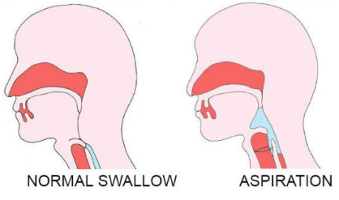
Dysphagia Screening for Stroke Patients
Definition:
Dysphagia is the medical term for difficulty swallowing or paralysis of the throat muscles. This condition can make eating, drinking, taking medicine and breathing difficult.
As per The Joint Commission requirements specific to Primary Stroke Certified Center, all patients exhibiting stroke symptoms require screening for dysphagia prior to receiving any oral intake of medication, fluids, or food.
Rationale:
One of the most common and earliest problems to emerge after a stroke is difficulty swallowing (dysphagia).
The prevalence of dysphagia in stroke patients ranges from 30% to 67%.
Dysphagia may result in aspiration, which occurs in approximately 20% to 25% of stroke patients.
Swallowing abnormality is associated with higher mortality and strongly correlated with pneumonia.
Pneumonia is approximately 7 times more likely to develop in patients who aspirate after stroke than in patients who do not.
In addition to mortality and chest infection, a significant relationship exists between dysphagia and malnutrition.

Slide 22
VS and Neuro Check Monitoring for Stroke Patients
Vital Signs:
Vital signs, while nonspecific, can point to impending clinical deterioration and may assist in narrowing the differential diagnosis.
Vital signs for the stroke patient would be checked and documented Q 4hr.
Neurological Assessment:
The neurologic assessment establishes a neurologic baseline should the patient's condition improve or deteriorate.
The primary nurse will assess and document Neurological Assessment (neuro checks): Q2 hours x 24-hr., then Q4 hours.
NIHSS:
A useful tool in quantifying neurologic impairment is the National Institutes of Health Stroke Scale (NIHSS). NIHSS must be documented within 12-hours of hospital arrival to the ED for all patients presenting with stroke or stroke like symptoms.
In a treatment setting, the scale has three major purposes.
It evaluates the severity of the stroke.
It helps determine the appropriate treatment.
It predicts patient outcomes.
The Primary nurse will assess and document NIHSS:
On arrival to the nursing unit
Q shift
At any change in patient condition
At discharge

Slide 23
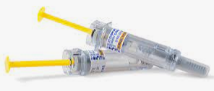
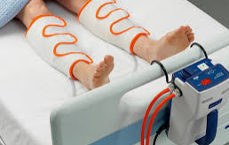
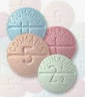
Deep Vein Thrombosis Prophylaxis
Chemical VTE Prophylaxis | Mechanical VTE Prophylaxis
Lovenox SQ | DVT boots-calf/thigh
Coumadin/Warfarin | SCDs
Heparin SQ only | Leg pumpers
Heparin IV, Apixaban, Xarelto are medical treatments not a Chemical prophylaxis | Elastic compression stockings is not appropriate VTE prophylaxis for stroke patients.
Deep vein thrombosis (DVT) is a serious complication in stroke patients and may lead to the devastating consequences of a pulmonary embolism.
Failure to recognize and protect acutely ill-hospitalized patients at risk for VTE increases their chances for developing DVT or dying from a PE.
VTE assessment MUST be addressed on every patient, every shift.
There are two types of VTE prophylaxis: Chemical and Mechanical
If unable to provide Chemical and Mechanical VTE prophylaxis (amputee, cellulitis, patient refused both prophylaxis’s, acute DVT, and surgery), notify provider and obtain VTE exclusion order.

Slide 24
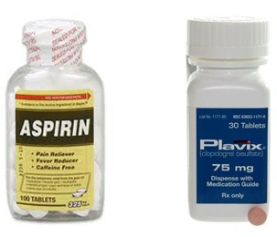
Antithrombotic Therapy by the End of Hospital Day-2
Antithrombotic are drugs that aim to restore tissue perfusion by maintaining blood flow.
Researchers have concluded that giving aspirin to stroke victims as soon as they arrive at the hospital reduces their risk of having a second stroke.
Early initiation of antithrombotic therapy reduces stroke mortality, morbidity and recurrence of the Stroke.
Requirements:
Based on clinical practice guidelines, antithrombotic therapy recommended by the end of Hospital Day-2*.
  *Day of arrival to the Emergency Department considered Day-1.
If patient cannot swallow/NPO or lethargic, than Aspirin suppository should be ordered.
If antithrombotic treatment is contraindicated (GI bleed, bleeding disorder, brain malignancy, etc.) need an Antithrombotic Contraindication exclusion order by the End of Hospital Day-2.
An allergy or adverse reaction to one type of antithrombotic would NOT be a reason for not administering all antithrombotic. Order needed for another type of antithrombotic medication or Antithrombotic Contraindication exclusion order by the End of Hospital Day-2.

Slide 25
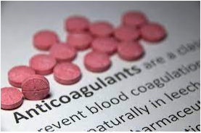
Anticoagulation Therapy for Stroke Patients with A-fib/flutter, Hx. A-fib/flutter or Hx. of Ablations
As per the Joint Commission Requirements specific to Primary Stroke Certified Center, Ischemic stroke patients with Atrial fibrillation/flutter require a prescription for Anticoagulation medication at hospital discharge.
Prior to hospital discharge, the RN must make sure that Anticoagulation tx prescribed for patients with documented A-fib/A-flutter or History of A-fib/ A-flutter.
If anticoagulation tx contraindicated, review Discharge order for Anticoagulation Contraindication reason. If there is no Anticoagulation tx contraindication reason documented, notify PCP and obtain Anticoagulation Contraindication order prior to discharge.
The most common cause of stroke is a blood clot. Atrial fibrillation (AF) describes the rapid, irregular beating of the left atrium (upper chamber) of the heart. These rapid contractions of the heart are weaker than normal contractions, resulting in slow flow of blood in the atrium. The blood pools and becomes sluggish and can result in the formation of blood clots.
The risk factors for stroke in patients with A Fib: Congestive Heart Failure, Hypertension, Age greater than 65, Diabetes, Prior Stroke or TIA, History of heart attacks or blockages in the neck or leg arteries.
Strokes caused by an irregular heart rhythm, called atrial fibrillation, often require blood-thinning medications to reduce the risk of future stroke.
Anticoagulants ("blood thinners") are the most effective treatment for preventing blood clots in people at high risk of stroke.
Blood thinners do not dissolve the clot, but they can stop it from getting bigger and keep new ones from forming. That gives your body time to break up the clot.
Taking an anticoagulant medication can reduce the risk of having a stroke by approximately 50 to 70 percent.

Slide 26

Antithrombotic Therapy for Stroke Patients at Discharge
As per the Joint Commission Requirements specific to Primary Stroke Certified Center, Ischemic stroke patients require a prescription for Antithrombotic medication at hospital discharge.
Prior to hospital discharge, the RN must make sure that Antithrombotic tx prescribed
If Antithrombotic tx contraindicated, review Discharge order for Antithrombotic Contraindication reason.
If there is no Antithrombotic tx contraindication documented, notify PCP and obtain Antithrombotic Contraindication order prior to discharge.
Antithrombotic are drugs that aim to restore tissue perfusion by maintaining blood flow.
Researchers have concluded that giving aspirin to stroke victims as soon as they arrive at the hospital reduces their risk of having a second stroke.
Early initiation of antithrombotic therapy reduces stroke mortality, morbidity and recurrence of the Stroke.

Slide 27
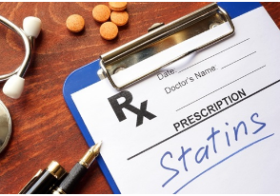
Statin Therapy for Stroke Patients at Discharge
As per the Joint Commission Requirements specific to Primary Stroke Certified Center, Ischemic stroke patients require a prescription for Statin medication at hospital discharge.
Prior to hospital discharge, the RN should assess the patient’s discharge medications to ensure Statin therapy prescribed.
Discuss with MD if there is no order for Statin therapy at discharge, Statin Contraindication Exclusion order needed prior to discharge.
Ischemic strokes – the most common type of stroke – may be caused by a buildup of cholesterol in the arteries, which blocks blood flow to brain.
Elevated cholesterol, low levels of high-density lipoprotein (HDL) and high levels of low-density lipoprotein (LDL) are associated with an increased risk of ischemic stroke.
Statins are drugs that can lower your cholesterol. They work by blocking a substance your body needs to make cholesterol.
These drugs may help stabilize the plaques on blood vessel walls and reduce the risk of certain blood clots.
Statins are considered the most important advance in stroke prevention since the introduction of aspirin and antihypertensive treatments.
The risk of having another stroke increased 42 percent for patients who stopped taking statins.
The risk of death from any cause increased 37 percent after discontinuing statins.

Slide 28

Rehab Therapy for Stroke Patients prior Discharge
As per The Joint Commission requirements specific to the Primary Stroke Certified Centers, Ischemic and Hemorrhagic stroke patients require assessment for rehabilitation services (PT/OT/ST) before discharge.
The primary goal of rehabilitation is to prevent complications, minimize impairments, and maximize function.
Expect orders for PT/OT/ST evaluation on all Stroke patients.
Prior to hospital discharge, make sure that PT/OT/ST assessment documented by Rehab department.
If PT/OT/ST contraindicated, Rehab. Contraindication exclusion order needed (see “Discharge Order”).
Stroke is the number one cause of serious adult disability in the United States.
Ten percent of stroke survivors recover almost completely.
Ten percent require care in a nursing home or other long-term care facility.
Twenty-five percent recover with minor impairments.
Forty percent experience moderate to severe impairments.
Physical therapists assess patients in the area of functional mobility. The aim of physical therapy is to have the stroke patient relearn simple motor activities such as walking, sitting, standing, lying down, and the process of switching from one type of movement to another.
Occupation therapists assess the impact of changes in motor function, sensation, coordination, visual perception, and cognition on person’s capacity to manage daily life tasks. Its goal is to help the stroke patient relearn everyday activities such as eating, drinking and swallowing, dressing, bathing, cooking, reading and writing, and using the toilet.
Speech therapists focus on patients’ cognitive impairments, language impairments (aphasia), speech impairments (dysarthria, apraxia), swallowing impairments (dysphagia), or other issues that affect a patient’s social interaction

Slide 29
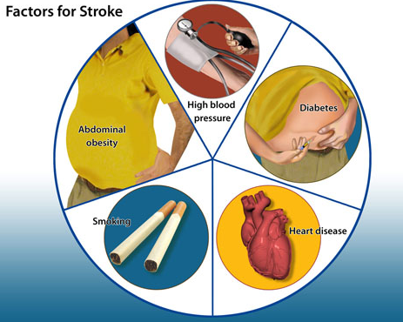
Stroke/TIA Risk Factors Education
Prior to hospital discharge, the RN must provide Stroke Education to all Stroke/TIA patients.
Stroke is the fifth leading cause of death in the United States.
Some medical conditions and lifestyle choices can put anyone—regardless of gender, ethnicity, or age—at risk for stroke.
More than 50% of strokes are preventable with lifestyle changes and healthier choices.
Knowing your risk factors for stroke is the first step in preventing a stroke.
With the support of health professionals like you, your patients would better understand how to manage their risk factors like high blood pressure, high cholesterol, obesity, and diabetes to prevent reoccurrence of the Stroke/TIA.
Practicing discharge timeout is one of the best approaches to ensure that we are providing required Individualized Stroke Risk Factors Education to our patients and correctly documenting it in Meditech.

Slide 30
Modified Rankin Scale
Most stroke survivors spent their lifetime with a disability that not only affects the clients themselves and their family, but, also brings economic impact to the country.
To understand post stroke recovery and to plan realistic rehabilitation goals, it is important to have a method of describing pre-stroke disability.
The modified Rankin Scale (mRS) measures the degree of disability or dependence in the daily activities of people who have suffered a stroke
Document the Modified Rankin Scale on every Stroke/TIA patient prior to Discharge using designated field of the Discharge instructions under Stroke certification documentation
# | mRs | Definition
0 | No symptoms at all | No symptoms at all.
1 | No significant disability | Able to carry out all usual duties and activities.
2 | Slight disability | Unable to carry out all previous activities, but able to look after own affairs without assistance.
3 | Moderate disability | Requiring some help, but able to walk without assistance.
4 | Moderately severe disability | Unable to attend to own bodily needs w/o assistance, and unable to walk unassisted.
5 | Severe disability | Requires constant nursing care and attention, bedridden, incontinent.
6 | Expired
7 | Unable to contact patient
8 | Not performed, UTD

Slide 31
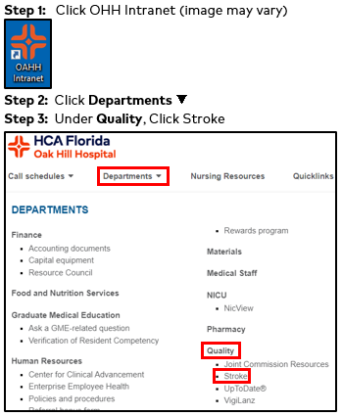
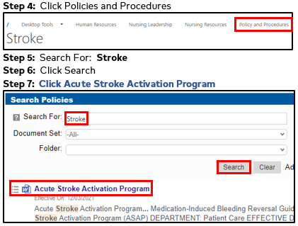
Stroke Alert Policy
Stroke Alert Policy:
Hold CTRL and Click Here and start at Step 5 or follow all steps below:

Slide 32

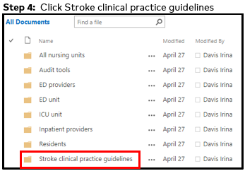
Clinical Practice Guidelines
Clinical Practice Guidelines:
Hold CTRL and Click Here and start at Step 5 or follow all steps below:

Slide 33
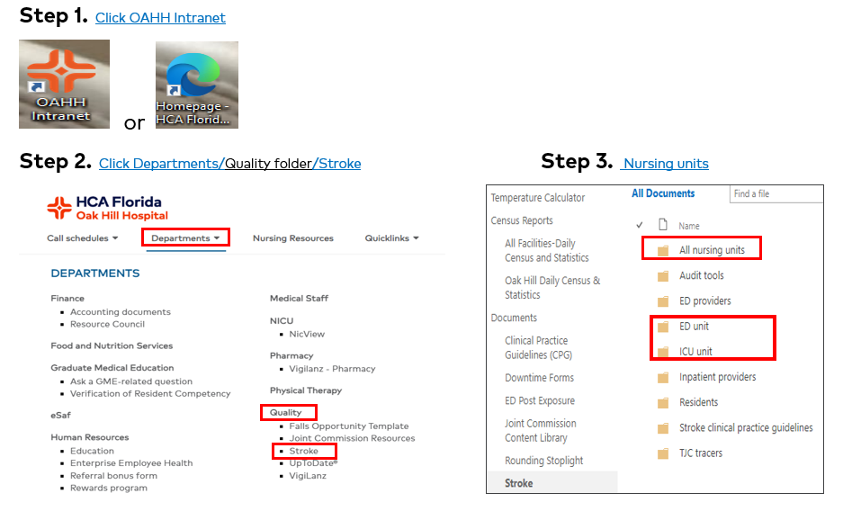
Nursing staff Stroke resources

Slide 34

Questions
Irina Davis, RN, Stroke Program Coordinator
  Irina.davis@hcahealthcare.com
Dr.Schwadron and Dr.Komurek, Stroke Program Physician Champions
Jonathan.Schwadron@hcahealthcare.com
Christopher.komurek@hcahealthcare.com

Slide 35
References
The American Heart Association requests that this document be cited as follows: Powers WJ, Rabinstein AA, Ackerson T, Adeoye OM, Bambakidis NC,Becker K, Biller J, Brown M, Demaerschalk BM, Hoh B, Jauch EC, Kidwell CS, Leslie-Mazwi TM, Ovbiagele B, Scott PA, Sheth KN, Southerland AM, Summers DV, Tirschwell DL; on behalf of the American Heart Association Stroke Council. Guidelines for the early management of patients with acute ischemic stroke: 2019 update to the 2018 guidelines for the early management of acute ischemic stroke: a guideline for healthcare professionals from the American Heart Association/American Stroke Association. Stroke. 2019;50:e●●●–e●●●. doi: 10.1161/STR.0000000000000211.
https://www.jointcommission.org/accreditation-and-certification/certification/certifications-by-setting/hospital-certifications/stroke-certification/advanced-stroke/primary-stroke-center/
Summers D, Leonard A, Wentworth D, Saver JL, Simpson J, Spilker JA, Hock N, Miller E, Mitchell PH: on behalf of the American Heart Association Council on Cardiovascular Nursing and the Stroke Council. Comprehensive overview of nursing and interdisciplinary care of the acute ischemic stroke patient: a scientific statement from the American Heart Association. Stroke. 2009; 40:2911–2944.
Bowry R, Navalkele DD, Gonzales NR. Blood pressure management in stroke: Five new things. Neurol Clin Pract. 2014;4(5):419-426.
Hafez S, Coucha M, Bruno A, Fagan SC, Ergul A. Hyperglycemia, acute ischemic stroke, and thrombolytic therapy. Transl Stroke Res. 2014; 5(4):442-453.
Validation of a Dysphagia Screening Tool in Acute Stroke Patients Jeff Edmiaston, Lisa Tabor Connor, Lynda Loehr and Abdullah Nassief Am J Crit Care 2010;19:357-364 doi: 10.4037/ajcc2009961 © 2010 American Association of Critical-Care Nurses Published online http://www.ajcconline.org
www.medscape.com/viewarticle/856300#vp_2
https://www.mayoclinic.org/diseases-conditions/high-blood-cholesterol/in-depth/statins/art-20045772
https://www.ninds.nih.gov/Disorders/All-Disorders/Atrial-Fibrillation-and-Stroke-Information-Page
Winstein CJ, Stein J, Arena R, Bates B, Cherney LR, Cramer SC, Deruyter F, Eng JJ, Fisher B, Harvey RL, Lang CE, MacKay-Lyons M, Ottenbacher KJ, Pugh S, Reeves MJ, Richards LG, Stiers W, Zorowitz RD; on behalf of the American Heart Association Stroke Council, Council on Cardiovascular and Stroke Nursing, Council on Clinical Cardiology, and Council on Quality of Care and Outcomes Research. Guidelines for adult stroke rehabilitation and recovery: a guideline for healthcare professionals from the American
Heart Association/American Stroke Association. Stroke. 2016: 47: XXX–XXX. DOI: 10.1161/STR.0000000000000098

